Slide 1



Winning Testimonials: Build Your Reputation with Proof of Performance
Learn & Grow Workshop Series
Presented by
Ryan Taylor, President Golden Gift Consulting
April 15, 2026

Slide 2

Agenda
Welcome and Introductions
Workshop: State Contracting Basics
OFM Vendor Payee Registration
Sales Reporting
Small Business Registration & Certifications
Scope & Quote Process
Winning Testimonials: Build Your Reputation with Proof of Performance
Q & A and Discussion (Workshop Topic)
Q & A about Statewide Contracts
Closing Remarks

Slide 3
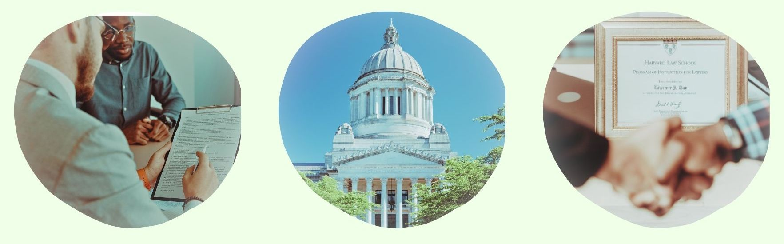
Part 1: State Contracting Basics:
OFM Vendor Payee Registration
Sales Reporting
Small Business Registration & Certifications
Scope & Quote Process

Slide 4
OFM Vendor Payee Registration
Register for OFM at: Vendor payee registration | Office of Financial Management
Enter business information.
Enter bank account information.
Monitor email for notification of acceptance, rejection, or clarification.

Slide 5

Sales Reporting
Complete Sales Report at the following link: DES Login.
Pay management fee for all revenue generated through the statewide contract during the quarter. Management fee amounts vary. You can find details about your management fee in your contract document.
Gross receipts = total revenue, not profit
(total income before expenses)
Invoice will be posted in account and emailed to you.
You must call the DES Payment Processing department at (360) 725-5700 to pay your invoice. You cannot pay through an online account.

Slide 6

Small Business Registrations & Certifications
Small business certifications (small business, veteran, MBE/WBE, etc.), if any, are listed next to firms on the DES contract portal page.
If you obtain OMWBE certification (or your certification status changes) after your contract award, notify your contracting officer to update your file.

Slide 7
Scope & Quote Process
Agencies will research firms
They conduct preliminary research to narrow down firms.
You should consider what the agency is looking for.
Outreach process
Agencies reach out to vendor(s) of interest to request quotes.
Agencies may request
Technical approach
Firm/staff qualifications
Price quote (cost of firm’s goods or services, materials, and other direct costs related to the scope of work)

Slide 8

Part 2: Winning Testimonials: Build Your Reputation with Proof of Performance

Slide 9
Overview: What We’ll Cover
Why Reputation Matters in Statewide Contracting
What Counts as Proof of Performance
How to Create Strong Testimonials
How to Ask for and Collect Testimonials
Using Testimonials in Your Marketing
Managing Online Presence and Responding to Reviews
Turning Work into Success Stories
Building a Long-Term Reputation Strategy

Slide 10
Build Your Reputation with Proof of Performance
A strong reputation is vital for attracting and retaining clients. Positive reviews and testimonials provide powerful social proof that builds trust and credibility. When potential customers see others speaking highly of a company, it validates their past performance, expertise, and dependability.

Slide 11

Why Reputation Matters in Statewide Contracting
Being awarded a contract does not guarantee work.
Buyers choose vendors they trust to be able to perform the work well.
Reputation reduces perceived risk in the minds of buyers.
Strong proof of performance speeds up decisions.
Reputation can be deciding factor when multiple vendors offer similar services.

Slide 12
What Counts as Proof of Performance
Client testimonials
Reviews and ratings
Case studies and success stories
Repeat clients and referrals
Before and after results
Buyers look for clear evidence that you have done this work successfully before.

Slide 13
The Buyer’s Perspective
Is this vendor reliable?
Have they worked on similar projects?
Have they worked with similar clients?
Do they deliver consistent results?
Can I justify selecting them?
Your reputation helps buyers feel confident and supported in their decision.

Slide 14

Testimonials as Social Proof
Third-party validation builds trust.
Reduces need for buyers to investigate.
Shows real outcomes, not claims.
Humanizes your business.
A strong testimonial answers questions before the buyer has to ask.

Slide 15
What Makes a Strong Testimonial
Specific service or project
Clear result or outcome
Client type or context
Short and easy to read
General praise is helpful, but specific results are far more powerful.

Slide 16
Weak vs Strong Testimonials
Weak: Great company, highly recommend.
Strong: Completed 15-unit cleaning ahead of schedule with zero rework.
Specific details make your work real and credible.

Slide 17
Be Proactive with Positive Reviews
Engage satisfied clients to provide reviews, testimonials, and case studies that emphasize the quality of the firm’s services. Positive reviews can be on many platforms, including:
The company’s own website Customer testimonials in a capability statement or marketing materials Google Business Yelp | Social media pages like Facebook or LinkedIn Better Business Bureau Industry-specific directories or forums
Focus on consistently delivering exceptional service to ensure positive experiences and build trust with clients.
Leverage positive client feedback in marketing efforts to demonstrate reliability and showcase capability, expertise, and success.
Reputation grows when great service is consistently captured and shared.

Slide 18
How to Ask for Testimonials
Ask right after successful completion.
Make it easy with a simple prompt.
Offer a short template if needed.
Request permission to use publicly.
Most clients are willing to help, they just need a clear and easy way to respond.

Slide 19
Ideas for Obtaining Reviews from Satisfied Clients
Create a QR code that links directly to the company’s Google, Yelp, or LinkedIn review page for easy access.
Send a follow-up email thanking clients and include direct links to review platforms with a request for feedback.
Call satisfied clients for a brief interview and ask to post their review on the company website or social media.
Include a review request note in invoices or receipts with clear instructions on how to leave feedback.
Train staff to ask for reviews after successful interactions with customers, especially in-person, since a satisfied customer may be willing to pull out their phone and write a review immediately.
Simple systems make review collection consistent and natural

Slide 20

Google and Yelp Presence
Buyers often search your business online.
Reviews reinforce credibility.
Consistent activity shows reliability.
Star ratings influence first impressions.
Your online presence is often your first impression before any conversation.

Slide 21

Responding to Reviews
Thank positive reviewers.
Address concerns calmly and professionally.
Show accountability and solutions.
Keep responses short and respectful.
Your responses show how you handle real situations, not just ideal ones.

Slide 22
Turning Work into Success Stories
Describe the client and challenge.
Explain your approach.
Highlight measurable results.
Keep it simple and clear.
A short story is easier to remember and more persuasive than a list of services.

Slide 23

Where to Use Testimonials
Website homepage and service pages
Capability statement
Proposals and emails
Social media and presentations
Place proof where buyers are already looking for information

Slide 24
Building a Reputation Strategy
Collect testimonials regularly
Track results and outcomes
Update website and materials
Align messaging with buyer needs
Reputation is built over time through consistent proof, not one strong project

Slide 25

Consistency Builds Trust
Deliver quality work every time.
Communicate clearly with clients.
Follow through on commitments.
Document your results.
Every project is an opportunity to strengthen or weaken your reputation.

Slide 26
Repairing Damage and Negative Reviews
Respond to negative reviews promptly and professionally, acknowledging the issue and offering to resolve it offline.
Apologize sincerely but wisely, and investigate the complaint, taking corrective action as needed.
Follow up with the reviewer to ensure satisfaction and update the company’s public response once the issue is resolved.
Regularly monitor reviews, encouraging happy customers to leave positive feedback to balance occasional negative comments.
Use the company’s Quality Assurance and continuous improvement processes to learn from mistakes and implement checks and systems to prevent future errors.
How you respond to problems often matters more than the problem itself.

Slide 27

Common Mistakes to Avoid
Only using generic testimonials
Not asking for reviews
Letting online profiles go inactive
Hiding proof deep in materials
Small gaps in visibility can make strong work go unnoticed.

Slide 28
Final Takeaways
Reputation drives buyer confidence.
Testimonials are one of your strongest tools.
Consistency matters more than perfection.
Start building your proof today.
Strong reputations are built step by step through real work and real results.

Slide 29
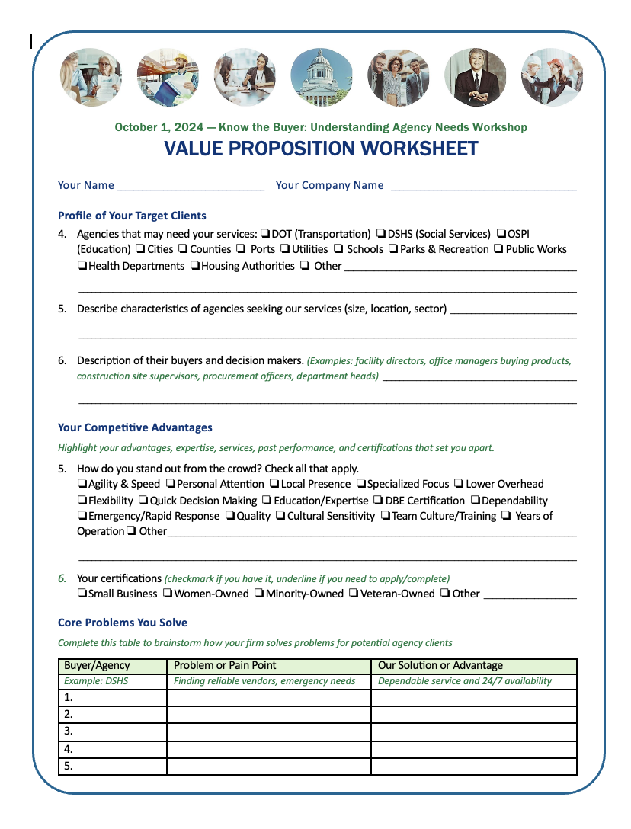
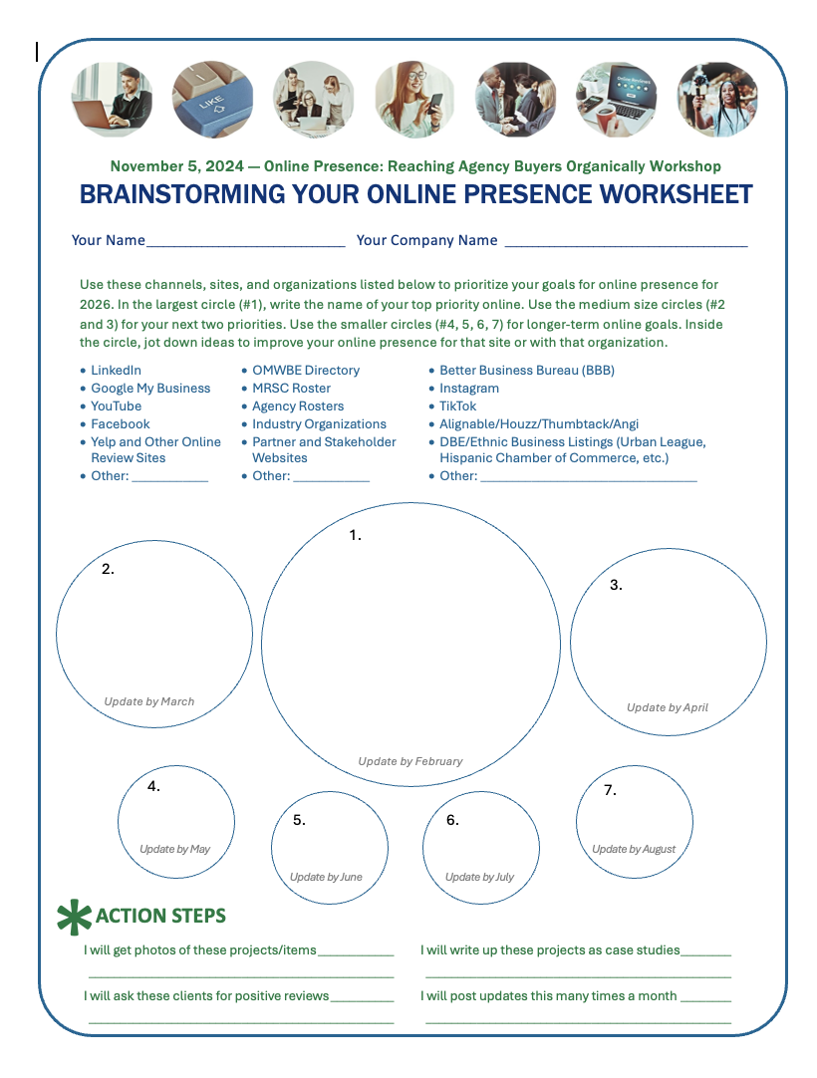
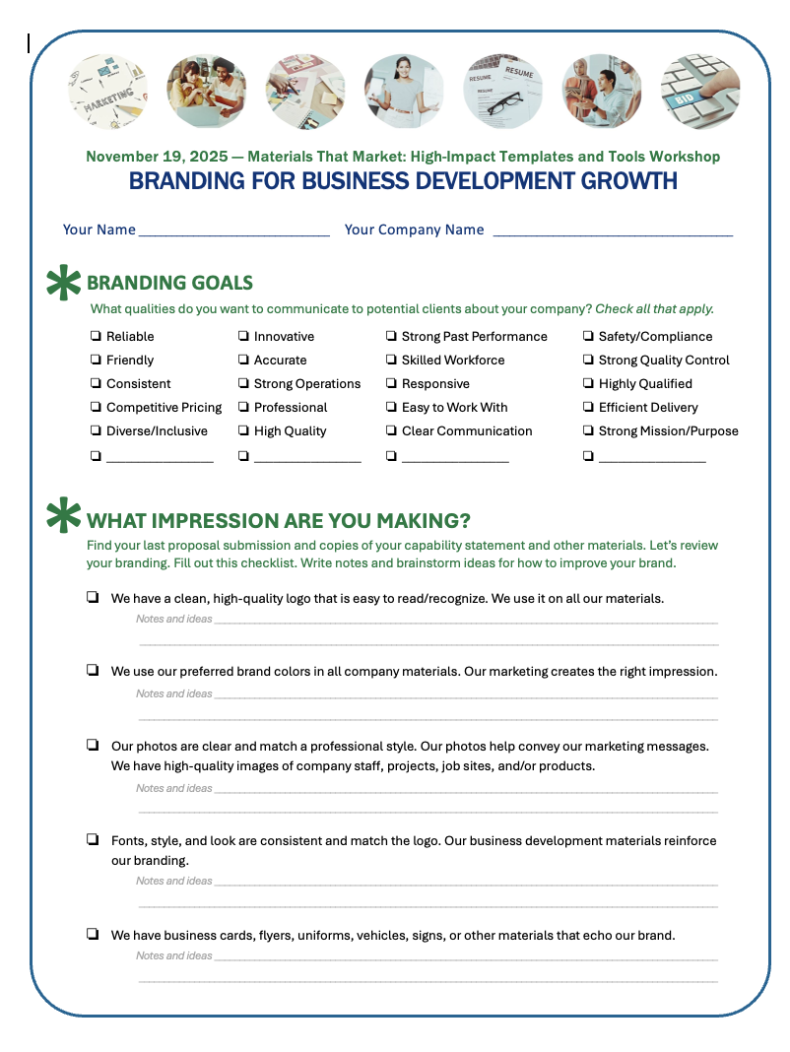
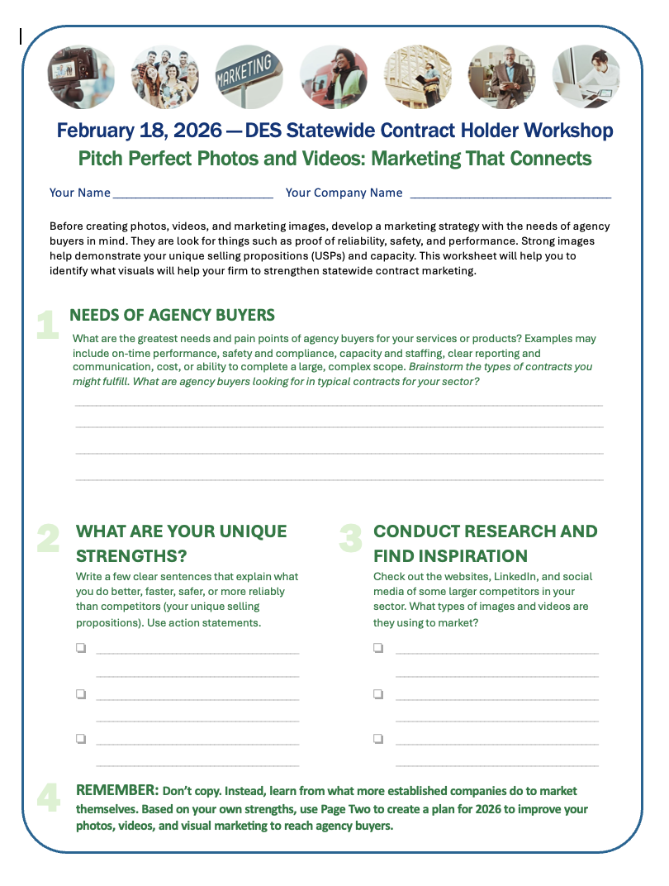
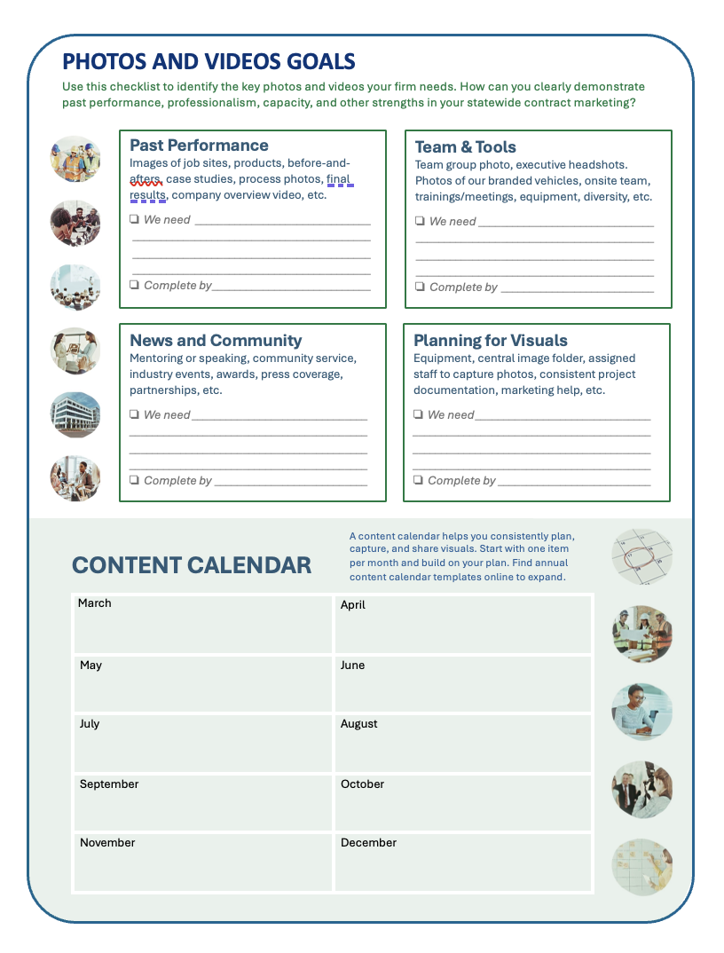
Worksheet
Want to dig deeper on the topic of networking for contracts? Every session we provide tutorials, tips, and creative brainstorming ideas for you to plan your next steps. Let’s take a quick look at this week’s resource guide.

Slide 30

Q & A: Testimonials
What questions do you have about testimonials or other evidence of performance?

Slide 31

Q & A: Statewide Contracting
What questions do you have about managing or marketing your statewide contract, WEBS, reporting, or other topics?

Slide 32
Closing
Thank you to DES for sponsoring the Learn & Grow: Statewide Contract Holder Workshop Series!
If you need support, reach out for resources.
The workshop presentation and handouts will be emailed to you.

Slide 33
Thank You! See you next time!
Ryan Taylor
206-397-7872
ryan@goldengiftconsulting.com
www.goldengiftconsulting.com

