Slide 1

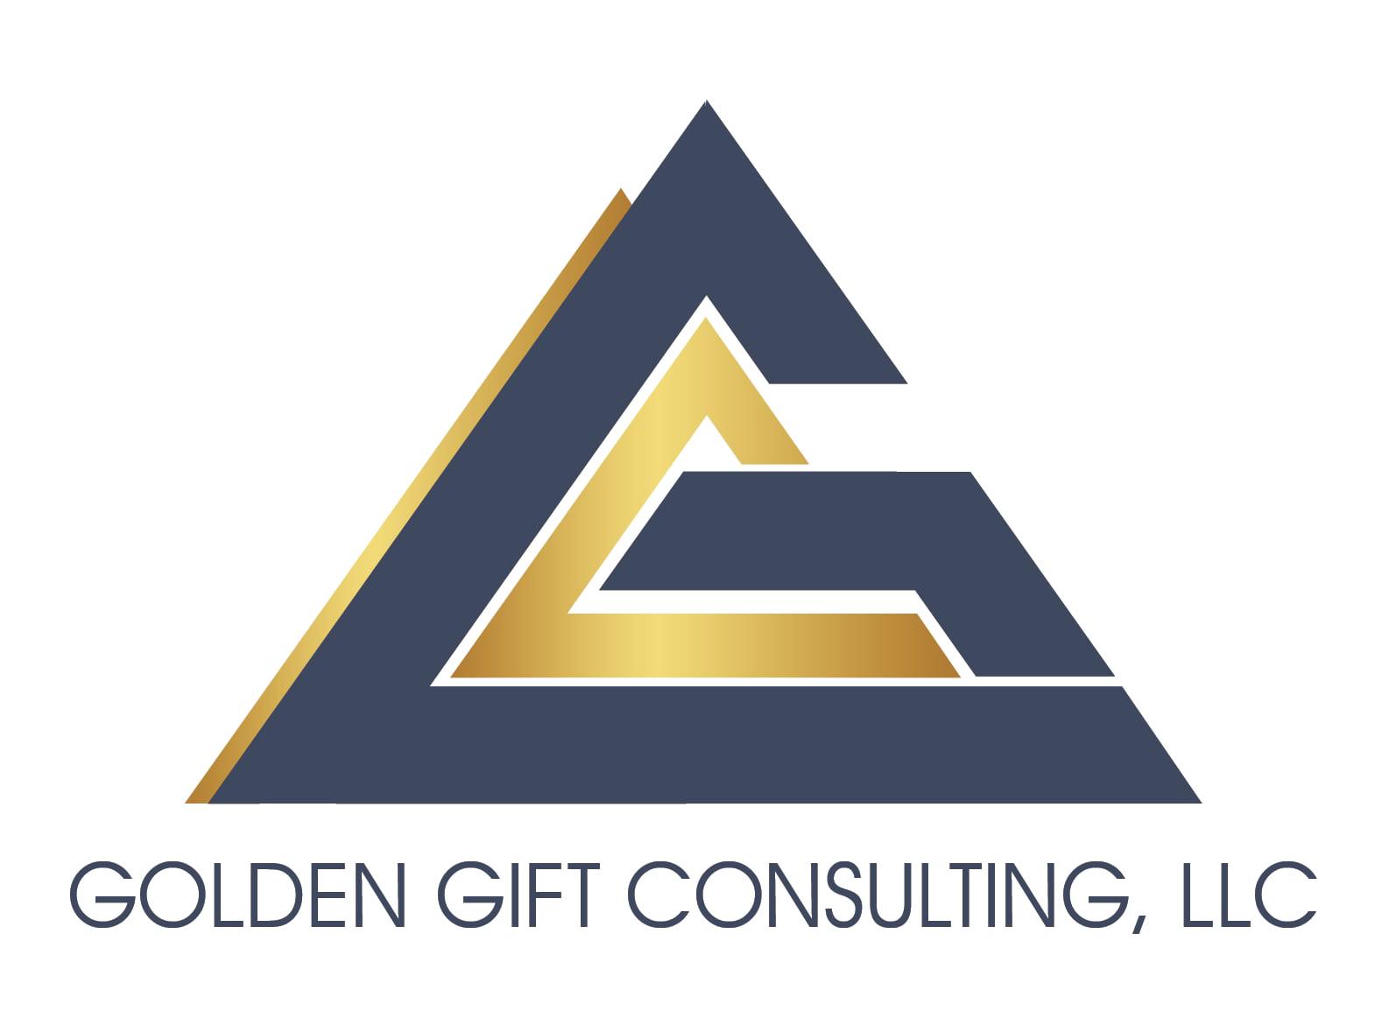

Proactive & Complimentary Marketing: Direct Buys, Rosters (MRSC, DSBS, OMWBE, etc.), & Business Databases
Learn & Grow Workshop Series
Presented by
Ryan Taylor, President Golden Gift Consulting
February 4, 2026

Slide 2

Agenda
Welcome and Introductions
Workshop—State Contracting Basics
OFM Vendor Payee Registration
Sales Reporting
Small Business Registration & Certifications
Scope & Quote Process
3. Workshop—Proactive & Complimentary Marketing: Direct Buys, Rosters, & Business Databases
4. Q & A and Discussion (Workshop Topic)
5. Q & A about Statewide Contracts
6. Closing Remarks

Slide 3

State Contracting Basics:
OFM Vendor Payee Registration
Sales Reporting
Small Business Registration & Certifications
Scope & Quote Process

Slide 4
OFM Vendor Payee Registration
Register for OFM at: Vendor payee registration | Office of Financial Management
Enter business information.
Enter bank account information.
Watch email for notification of acceptance, rejection, or clarification.

Slide 5

Sales Reporting
Complete Sales Report at the following link: DES Login.
Pay management fee for all revenue generated through the statewide contract during the quarter. Management fee amounts vary. You can find details about your management fee in your contract document.
Gross receipts = total revenue, not profit
(total income before expenses)
Invoice will be posted in account and emailed to you.
You must call the DES Payment Processing department at (360) 725-5700 to pay your invoice. You cannot pay through an online account.

Slide 6
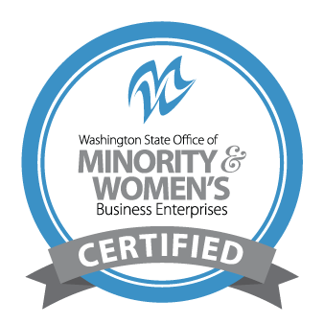
Small Business Registrations & Certifications
Small business certifications (small business, veteran, MBE/WBE, etc.), if any, are listed next to firms on the DES contract portal page.
If you obtain OMWBE certification (or your certification status changes) after your contract award, notify your contracting officer to update your file.

Slide 7
Scope & Quote Process
Agencies will research firms
They conduct preliminary research to narrow down firms.
You should consider what the agency is looking for.
Outreach process
Agencies reach out to vendor(s) of interest to request quotes.
Agencies may request
Technical approach
Firm/staff qualifications
Price quote (cost of firm’s goods or services, materials, and other direct costs related to the scope of work)

Slide 8

Proactive & Complimentary Marketing: Direct Buys, Rosters (MRSC, DSBS, OMWBE, Etc.), & Business Databases

Slide 9

Proactive & Complimentary Marketing
Many agencies and organizations besides state agencies can purchase your products or services.
Non-state agencies
Federal agencies
Publicly funded institutions
Other nonprofit organizations
Many strategies, tools, and business development processes used to manage and develop new business under your statewide contract can also support developing new business in other areas of government contracting.
Many strategies referenced in the Post-Contract Award Series also apply to securing work with these types of organizations.
Diversifying your efforts will increase your ROI by creating opportunities to grow your business and generate additional income streams.
You can leverage these additional opportunities while you continue to pursue work through your statewide contract.
Notes:
Ryan, here’s my proposed talking point: “Why are we starting here? Because all of your marketing materials should have the same branding. Everything we are going to talk in this workshop should be branded with your company’s logo, palette, font, images, etc. “ Then remind them on each subsequent slide to BRAND THEIR MATERIALS

Slide 10
Proactive & Complimentary Marketing – Leveraging Tools
You can leverage many of the tools you create to develop new business under your statewide contract to also develop new business with public agencies and institutions outside of the statewide contracting consortium. The tools you may repurpose include, but are not limited to:
Website & Integrated Software
Capability Statement
Statement of Qualifications
Proposal Template Library
Professional Bios & Resumes
Professional Liability Insurance
Accounting Software
Pricing Structures & Indirect Rate Calculations
Project & Client Case Studies
Client Testimonials
Customer Relationship Database
LinkedIn & Other Social Media
Google My Business & Other Search Engine Listing Pages
Print Media-Marketing Collateral
Video Production Collateral
Newsletter Program & Software & Other Digital Marketing Collateral
Notes:
Ryan, here’s my proposed talking point: “Why are we starting here? Because all of your marketing materials should have the same branding. Everything we are going to talk in this workshop should be branded with your company’s logo, palette, font, images, etc. “ Then remind them on each subsequent slide to BRAND THEIR MATERIALS

Slide 11
Publicly Funded Agencies Inbound – Rosters & Business Databases
Publicly funded agencies purchase services from vendors every day in Washington state by referencing various platforms and utilizing various contracting instruments.
Rosters: Register on Rosters. This allows public agencies and institutions' to view your registration, business description, NAICS codes, location, and more to determine whether they would like to request a quote from your firm. Commonly used rosters include the MRSC, King County SCS, and other rosters established and used by local agencies.
Business Databases: Registering for business databases will allow local agencies to locate and learn more about your firm when they are researching firms from which to request quotes for projects.

Slide 12
Publicly Funded Agencies – Inbound Pools, Rosters, Qualified Vendor List
Competitive Vendor Pools:
Many agencies issue solicitations for vendors to supply specific products or services.
With these solicitations, you are one of the few awarded vendors that the agency can choose from to provide products or services when needed.
The qualified vendor pool contracts are in effect for a specific period, typically 2 to 5 years. They are usually longer than annual contracts because vendors are expected to put in the effort to apply, with a guarantee of a minimum amount of work.
While you are pursuing work through your statewide contract, making your firm available to agencies and organizations through these methods will allow your firm to increase visibility, secure work outside of your statewide contract, create additional income streams, and potentially capture smaller projects as lower-hanging fruit through direct buys.

Slide 13
Publicly Funded Agencies – Inbound Pools, Rosters, Qualified Vendor List (Continued)
Note: It is often helpful to apply the relationship-nurturing strategies discussed in our prospecting workshop (Workshop #4) to build and maintain relationships with the contract facilitators throughout the term of your contract.
Maintaining an active relationship with your contract manager could increase the likelihood they will reach out to you for a quote, because they will already be well versed in your organization’s capabilities.

Slide 14
Publicly Funded Agencies – Outbound Marketing
You’ve developed strategies and tools to research buyers, understand your value, and convey it to agency buyers. Strategies and methods for these elements were discussed in Workshops 3 and 4. You can refer to the workshop recordings for more information.
To increase your return on investment, you can also leverage these strategies and tools to develop business with non-state agencies and public institutions that do not regularly use the statewide contract.
Notes:
Note: you can get a logo designed cheaply using AI or Fivver

Slide 15
Publicly Funded Agencies – Outbound Marketing – Understanding The Buyer
Identify target clients – Identify agency buyers that have a significant need for the products and or services your firm provides.
Competitive advantages – Determine what makes your firm competitive in your market. What is the advantage of agency buyers working with your firm versus your competitors?
What problems do you solve? – Be clear on the problems you solve for the agency buyers that you will target. This will help you thoroughly convey your value to them.
Value propositions – Identify the top 2 to 5 ways your firm brings significant value to agency buyers who contract with you. Present your value propositions in clear, concise statements that thoroughly describe the benefits agencies will receive by contracting with you.
Note: It is important that agency buyers clearly understand the value you offer and the specific advantages of contracting with you over one of your competitors. If agency buyers lack this foundational information, they are more likely to select another vendor that can communicate it more effectively.
Notes:
Note: you can get a logo designed cheaply using AI or Fivver

Slide 16
Publicly Funded Agencies – Outbound Marketing – Understanding The Buyer
2. Agency Buy Research - Researching prospective client agencies’ past spending trends will help you gain insight into which buyers you should target based on their past purchasing of goods or services your firm provides.
fiscal.wa.gov – This website platform allows you to review exactly which agencies purchased products or services from specific vendors. This will help you identify which agencies are spending on products or services in your industry.
WEBS – This website platform allows you to review which agencies have posted solicitations for products or services within your industry. Reviewing past solicitations will allow you to see specific information about the products or services agencies have been purchasing, including quantity, pricing insights, timing, delivery methods, qualifications desired, rules and regulations, and other specifications that may impact how you market and sell your products and services.
Note: Many other platforms provide insights into the past purchasing behavior of Washington State agencies and others.
Notes:
Note: you can get a logo designed cheaply using AI or Fivver

Slide 17
Prospecting - Step 1: Identify Target Prospects
You should investigate these aspects of your prospective clients:
Target departments – The divisions within the company that require your products or services.
Key contacts – Individuals within the organization who have a need for your offerings.
Current resources – Any personnel or contractors associated with the organization who already supply products or services you offer, provide related support, or could potentially fulfill the demand for your goods if approached.
Additional information about your target clients.

Slide 18
Step 2: Connect with Target Prospects - Networking
Attend government contracting and diversity events to connect with agency leads and procurement officers.
Research agency spending reports to identify which agencies are purchasing goods or services you provide.
Register in government databases like WEBS and SAM.gov, to connect with procurement officials.
Leverage small business programs and certifications to gain access to technical assistance, training, and networking events.
Participate in small business and contracting events hosted by agencies to meet buyers and build relationships through follow-up.

Slide 19
Prospecting - Step 3: Hold 1:1 Meetings
Reach out to the target contact person(s) to introduce yourself and schedule a one-on-one meeting.
Send the prospect an email.
Call the prospect.
Message the prospect through LinkedIn or other social media.
Obtain an introduction to the lead from a mutual connection.
Meet the lead at an event.
Visit the prospect’s office if a drop-in is appropriate.

Slide 20
Prospecting - Step 4: Qualifying Leads
Do potential customers have the need, budget, and authority to decide on purchasing your product or service?
Evaluate the urgency and timeline of their decision-making to gauge when they might commit.
Investigate their business to confirm they align with your target market in terms of size, industry, and location.
Focus on leads that have shown clear interest through inquiries, engagement, or participation in events.
Allocate more time to leads with a strong chance of conversion while reducing effort on those with lesser potential.

Slide 21
Prospecting - Step 5: Nurture Relationships
Following up is important. Most new business will come from prospective buyers, not the first meeting.
Stay in contact with representatives you meet.
Prospective buyers usually don't purchase services at the first introductory meeting.
Keep following up, but ensure that all follow-up brings value to the client. You don't want to check in with them only to see if they have work for you, which may irritate them rather than create gratitude and anticipation of the value they will receive.

Slide 22
Prospecting - Step 6: Evaluate for Success
Evaluate success of business development activities monthly. A successful prospecting program can realistically take 6 months to 2 years or more to convert approximately 20-30% of prospects into clients, and 5 years to convert 30-40%.
How many new prospective buyers have you brought into your pipeline this month? Are you doing enough prospecting to meet your success goals, or at least your minimum revenue threshold?
How many of your prospects are converting each month? Are you certain they have a strong enough need for your services? Are your value propositions resonating with prospects? If not, consider researching competitors’ propositions that secure significant work in your industry and revisiting the value proposition exercise.
Is there a common barrier, objection, or hesitation? If so, consider doing research to develop a plan to overcome objections or compensate for them.

Slide 23
Publicly Funded Agencies – Outbound Marketing
Prospecting and relationship-building are at the heart of the outbound marketing strategies we recommend for Small Businesses. There are other outbound marketing channels that complement and support the prospecting and relationship-building process.
Responding to Solicitations – Responding to solicitations allows you to directly propose on projects that are open for bid. When used alongside prospecting and relationship-building, it increases ROI and creates new business opportunities for your firm.
Newsletter – Developing a newsletter will help you stay in touch with your clients and stakeholders and provide them with value-added information to nurture the relationship.
Video Production – Developing videos will help you communicate important information about your products and services to existing and past clients, new prospective clients, and community and industry stakeholders. This can support your business development efforts by efficiently reaching hundreds or thousands of people with a single video.
Publications and Presentations – Authoring or contributing to publications and conducting presentations related to your industry will help you build your name and reputation as a subject matter expert in your field.
Notes:
Note: you can get a logo designed cheaply using AI or Fivver

Slide 24

Reminder Before Q&A: Next Session
Wednesday, February 18th - 6:00 – 7:30 pm
Pitch Perfect Photos and Videos: Marketing That Genuinely Connects

Slide 25

Q & A: Online Presence
What questions do you have regarding developing outstanding, high-impact marketing materials?

Slide 26

Q & A: Statewide Contracting
What questions do you have about managing or marketing your statewide contract, WEBS, reporting, or other topics?

Slide 27
Closing
Thank you to DES for sponsoring the Learn & Grow: Statewide Contract Holder Workshop Series!
If you need support, reach out for resources.
The workshop presentation and handouts will be emailed to you.
Next workshop is Pitch Perfect Photos and Videos: Marketing That Genuinely Connects
Wednesday, February 18 at 6:00 pm.

Slide 28
Thank You! See you next time!
Ryan Taylor
206-397-7872
ryan@goldengiftconsulting.com
www.goldengiftconsulting.com

