Slide 1



Networking for Contracts: Enhancing Outreach, Research, and Visibility Through Agency Connections
Learn & Grow Workshop Series
Presented by
Ryan Taylor, President Golden Gift Consulting
March 18, 2026

Slide 2

Agenda
Welcome and Introductions
Workshop: State Contracting Basics
OFM Vendor Payee Registration
Sales Reporting
Small Business Registration & Certifications
Scope & Quote Process
Networking for Contracts: Enhancing Outreach, Research, and Visibility Through Agency Connections
Q & A and Discussion (Workshop Topic)
Q & A about Statewide Contracts
Closing Remarks

Slide 3
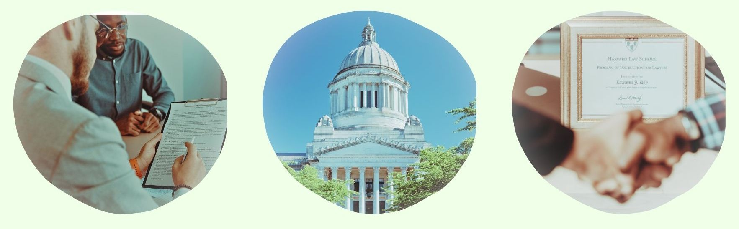
State Contracting Basics:
OFM Vendor Payee Registration
Sales Reporting
Small Business Registration & Certifications
Scope & Quote Process

Slide 4
OFM Vendor Payee Registration
Register for OFM at: Vendor payee registration | Office of Financial Management
Enter business information.
Enter bank account information.
Monitor email for notification of acceptance, rejection, or clarification.

Slide 5

Sales Reporting
Complete Sales Report at the following link: DES Login.
Pay management fee for all revenue generated through the statewide contract during the quarter. Management fee amounts vary. You can find details about your management fee in your contract document.
Gross receipts = total revenue, not profit
(total income before expenses)
Invoice will be posted in account and emailed to you.
You must call the DES Payment Processing department at (360) 725-5700 to pay your invoice. You cannot pay through an online account.

Slide 6

Small Business Registrations & Certifications
Small business certifications (small business, veteran, MBE/WBE, etc.), if any, are listed next to firms on the DES contract portal page.
If you obtain OMWBE certification (or your certification status changes) after your contract award, notify your contracting officer to update your file.

Slide 7
Scope & Quote Process
Agencies will research firms
They conduct preliminary research to narrow down firms.
You should consider what the agency is looking for.
Outreach process
Agencies reach out to vendor(s) of interest to request quotes.
Agencies may request
Technical approach
Firm/staff qualifications
Price quote (cost of firm’s goods or services, materials, and other direct costs related to the scope of work)

Slide 8

Networking for Contracts: Enhancing Outreach, Research, and Visibility Through Agency Connections

Slide 9
Overview: What We’ll Cover
Industry and Agency Events
Public Committees and Boards
Industry Associations and Networking
Following Up on Leads
Networking Best Practices
Key Takeaways and Next Steps

Slide 10

Introduction: Networking Builds Connections
Networking can help make your business as visible, establish credibility, and position you for statewide agency work.
Introductory meetings, followed up by professional, informative communication that brings value to agencies is an organic way to market without a hard sales approach.

Slide 11

Industry and Agency Events: Getting in the Room
Conferences and small business events are one avenue for agency buyers and procurement officers to build professional networks and meet vendors.
State agencies also host their own outreach events to connect directly with qualified vendors.

Slide 12
Industry and Agency Events: Staying Notified
Find calendars and subscribe to newsletters and event alerts to stay informed about upcoming networking opportunities. Examples:
Tabor 100 events calendar: tabor100.org/events
Washington APEX Accelerator free government contracting workshops: washingtonapex.org
OMWBE newsletter and certification events: omwbe.wa.gov/about-omwbe/newsletters
DES updates, news, and procurement notifications: public.govdelivery.com/accounts/WADES/subscriber/new
City of Seattle procurement calendar: procurement.opengov.com/portal/seattle/calendar
For more resources, see this session’s worksheet.

Slide 13

Industry and Agency Events: Which Events to Attend?
Choose events carefully to save time and resources. Focus on events in your sector where agency buyers participate, not vendor-only networking events.
Review and confirm that agency buyers relevant to your service area or product line will attend.
Review the attendee list in advance, if available.
Go in with a clear goal. Identify at least two or three agency staff to meet.
At some events, such as Alliance NW, you can schedule one-on-one meetings with agency buyers when you register.

Slide 14
Industry and Agency Events: Networking Basics
Arrive prepared with current capability statement, business cards, and a portfolio to jot notes.
Dress professionally.
Practice a 30-second description of your company and its offerings.
Approach agency staff directly at their tables or booths.
Be prepared to write down notes and contact info, hand out and receive business cards and materials, and organize materials collected so you can follow up in a timely manner.
It’s helpful to jot down what you discussed so you can reference this in the follow-up email.

Slide 15
Industry and Agency Events: Discussion Topics
Open with questions about their current projects and procurement priorities. Listen carefully.
Ask for contact info or a point of contact for a staff person in your sector/line of business.
Ask about typical agency needs, upcoming solicitations, and their budget cycle timeline.
Share your 30-second description, value propositions, capability statement, and materials.

Slide 16

Industry and Agency Events: Staying in Contact
When closing the conversation, exchange contact information. Let them know you will follow up by email with relevant information from your conversation.
If an agency staff member expresses interest in learning more, ask whether they would be open to a brief follow-up meeting.
You can make this request in person or in an email after the event. We will cover this in the Follow Up section.
Follow up within a timely manner, e.g., 24–48 hours.

Slide 17
Interactive Discussion Break
What events have you attended, or are interested in attending this year?
Share a time you met an agency staffer who helped you learn more about their agency’s needs.
What experience have you had attending a pre-bid meeting or small business event? Was it easy to meet agency staff and ask questions?
How do you usually follow up after meeting a contact to stay connected and learn about opportunities?
How comfortable are you with follow-up emails or requesting a short one-on-one meeting?

Slide 18
PUBLIC COMMITTEES AND BOARDS

Slide 19
Public Committees and Boards
Another way to network with other firms and agency staff is to serve on an advisory board, workgroup, or professional committee.
These organizations offer an opportunity to build and share your subject-matter expertise and participate in your industry sector.
Begin at the local level. Join a chamber, small business board, or neighborhood association. Establish a record of participation before pursuing sector or state-level boards.
In these groups, you will learn more about your sector, agencies in your sector, industry challenges, and contract priorities.
Some committees look for small business owners to share their perspective and help shape policy.

Slide 20
INDUSTRY AND PROFESSIONAL ASSOCIATIONS

Slide 21

Industry and Professional Associations
Industry associations are professional groups in your sector that bring members together to share resources, advocate for their interests, influence policy, and offer networking and professional development opportunities.
For example, Society for Human Resource Management (SHRM), Associated General Contractors (AGC)

Slide 22
Industry and Professional Associations
Industry associations in your sector can offer great networking opportunities, along with certifications, conferences, and other resources.
Membership gives you access to valuable education and networking on a recurring basis. You can add your membership designation to marketing materials also.
Regular participation, including committee service and presenting at events, can build professional recognition over time.
Like member firms, agency staff often participate in professional associations in their field for professional development and networking.
Note: Membership fees vary, research cost vs. value.

Slide 23

Following Up On Leads
Once you’ve attended events, received contact info, and started a conversation, what’s next?

Slide 24
Following Up with Leads
Step 1: Identify and Qualify
Find out whether your contact is involved in purchasing decisions. Look up the agency’s contract spending in your service area.
Step 2: Send First Follow- Up Email
Within 24 hours, send a brief thank-you email. Mention your conversation. Consider attaching your capability statement.
Step 3: Send Follow-Up Materials
In about a week, email any links, articles, or materials you offered.
Step 4: Request a Meeting
In approximately one to two weeks, connect on LinkedIn, if appropriate, and request a 30-minute introductory meeting.
Smart and consistent follow-up helps you stay connected, understand agency needs, and stay informed about upcoming opportunities. Typical steps include:

Slide 25
Following Up with Leads
Step 5: Provide Value
After the first month, send a follow-up email every month or two, such as a relevant article or industry development.
Step 6: Maintain Contact
On an ongoing basis, check in every two to three months with something useful or relevant. Keep the conversation going at in-person events.
Step 7: Annual Check-Ins
Share company updates, useful news, or industry articles to stay visible. See the Emails and Newsletter workshop for ideas.
Step 8: Contracts and RFPs
Smart networking helps firms to continually improve and write better proposals. You have listened and learned about agency needs.
After the first week, continue to stay in touch with your agency contacts.

Slide 26

Networking Best Practices
Focus: Listen to what the agency needs. Where appropriate, share your capability to help. Respect agency staff time, keep conversations concise.
Remember: Connections with public agency contacts develop authentically over time. Outreach that moves too quickly toward sales language can undermine trust.
Ethics: State employees must follow strict ethics policies when interacting with vendors. Do not offer gifts or incentives. Professional connections with agency representatives should never be viewed as a special advantage. Contracts are awarded through a fair, competitive process.
Long-term view: Build a positive, professional reputation through consistent, ethical engagement and delivering quality work. Networking is a long-term business development strategy.

Slide 27

Key Takeaways: Four Principals to Guide Networking
Your statewide contract opens the door. Consistent, professional outreach helps to find opportunities.
Select two or three events or associations where your target buyers participate. Plan for long-term, smart networking.
Establish a simple system for tracking contacts, follow-up dates, and next planned steps.
Networking works best with strong performance. Building professional visibility and learning more about agency needs will help you improve your service offerings and craft better bids/proposals.

Slide 28

Recommended First Actions
This week: Subscribe to newsletters from APEX Accelerator, Tabor 100, MBDA, and OMWBE.
This month: Send one networking email to an agency staff member you have previously met.
Next three months: Identify one upcoming event and one professional association to research in your service area. Consider attending Alliance NW, the largest small business government contracting conference in Washington State, on Thursday, March 26, 2026, at the Greater Tacoma Convention Center. (There may be a discount code for DBE-certified firms.) https://alliancenorthwest.org/
Before your next event: Update your capability statement and LinkedIn profile.

Slide 29
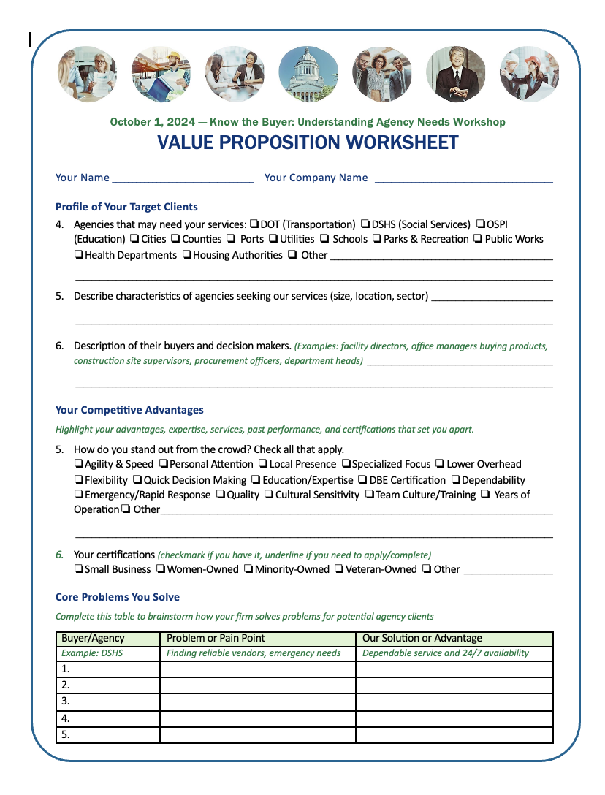
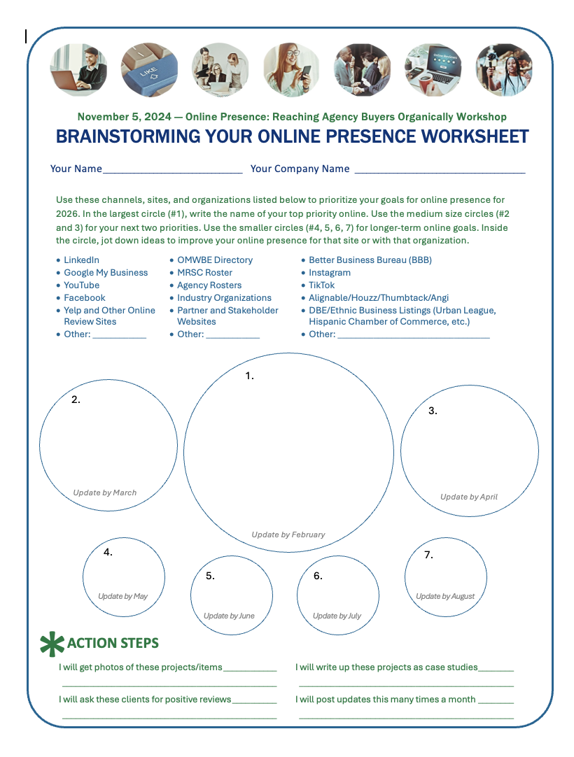
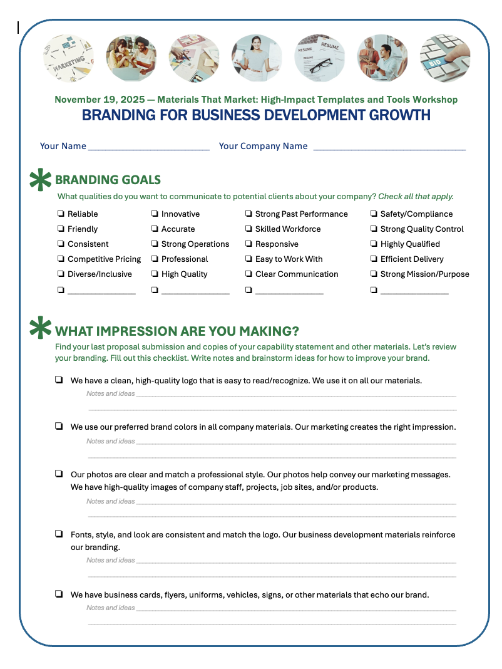
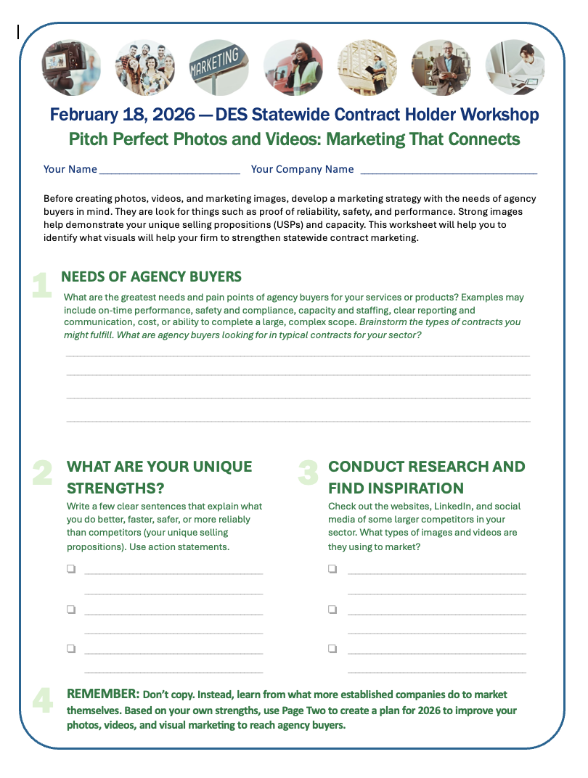
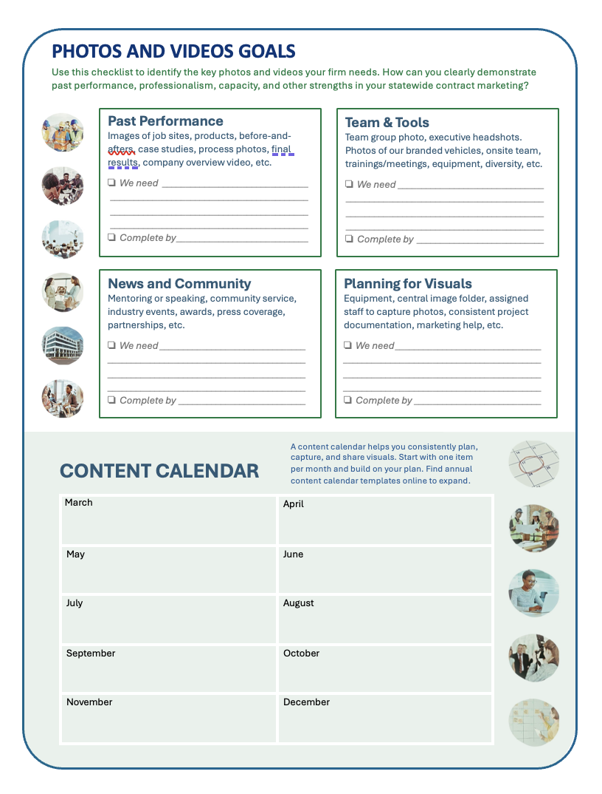
Worksheet
Want to dig deeper on the topic of networking for contracts? Every session we provide tutorials, tips, and creative brainstorming ideas for you to plan your next steps. Let’s take a quick look at this week’s resource guide.

Slide 30

Reminder Before Q&A: Next Session
Wednesday, April 1
6:00 – 7:30 pm
Successful Subcontractors: Building Your Team

Slide 31

Q & A: Networking
What questions do you have about networking, outreach, events, and connecting with agency staff who purchase through statewide contracts?

Slide 32

Q & A: Statewide Contracting
What questions do you have about managing or marketing your statewide contract, WEBS, reporting, or other topics?

Slide 33
Closing
Thank you to DES for sponsoring the Learn & Grow: Statewide Contract Holder Workshop Series!
If you need support, reach out for resources.
The workshop presentation and handouts will be emailed to you.
Next workshop is Successful Subcontractors: Building Your Team, Wednesday, April 1, at 6:00 pm.

Slide 34
Thank You! See you next time!
Ryan Taylor
206-397-7872
ryan@goldengiftconsulting.com
www.goldengiftconsulting.com

