Slide 1



Strategic Emails and Newsletters: Adding Value and Staying Engaged with Agencies
Learn & Grow Workshop Series
Presented by
Ryan Taylor, President Golden Gift Consulting
March 4, 2026

Slide 2

Agenda
Welcome and Introductions
Workshop—State Contracting Basics
OFM Vendor Payee Registration
Sales Reporting
Small Business Registration & Certifications
Scope & Quote Process
Strategic Emails and Newsletters: Adding Value and Staying Engaged with Agencies
Q & A and Discussion (Workshop Topic)
Q & A about Statewide Contracts
Closing Remarks

Slide 3
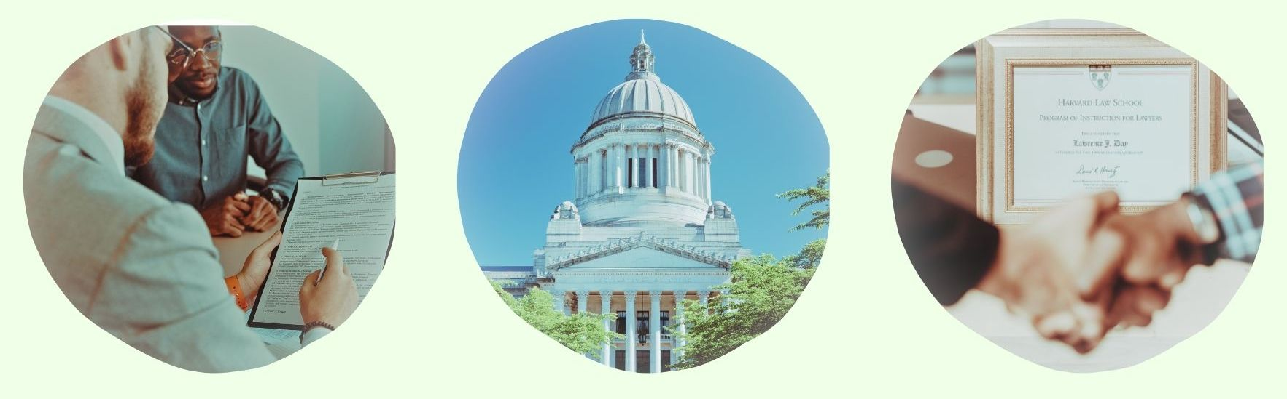
State Contracting Basics:
OFM Vendor Payee Registration
Sales Reporting
Small Business Registration & Certifications
Scope & Quote Process

Slide 4
OFM Vendor Payee Registration
Register for OFM at: Vendor payee registration | Office of Financial Management
Enter business information.
Enter bank account information.
Watch email for notification of acceptance, rejection, or clarification.

Slide 5

Sales Reporting
Complete Sales Report at the following link: DES Login.
Pay management fee for all revenue generated through the statewide contract during the quarter. Management fee amounts vary. You can find details about your management fee in your contract document.
Gross receipts = total revenue, not profit
(total income before expenses)
Invoice will be posted in account and emailed to you.
You must call the DES Payment Processing department at (360) 725-5700 to pay your invoice. You cannot pay through an online account.

Slide 6

Small Business Registrations & Certifications
Small business certifications (small business, veteran, MBE/WBE, etc.), if any, are listed next to firms on the DES contract portal page.
If you obtain OMWBE certification (or your certification status changes) after your contract award, notify your contracting officer to update your file.

Slide 7
Scope & Quote Process
Agencies will research firms
They conduct preliminary research to narrow down firms.
You should consider what the agency is looking for.
Outreach process
Agencies reach out to vendor(s) of interest to request quotes.
Agencies may request
Technical approach
Firm/staff qualifications
Price quote (cost of firm’s goods or services, materials, and other direct costs related to the scope of work)

Slide 8

Strategic Emails and Newsletters: Adding Value and Staying Engaged with Agencies

Slide 9

Strategic Emails and Newsletters Add Value and Help You Stay Engaged with Agencies
In this workshop, we will explore how emails and newsletters serve as proven marketing tools for building relationships with potential clients
They can help position your business as visible, credible, and prepared for statewide agency work.
Professional, informative updates that add value allow you to market your services organically without relying on a hard sales approach.

Slide 10
Think Strategically with Emails
Treat email and newsletters as long-term relationship builders, not as sales blasts.
Build trust with agency buyers by sharing consistent, useful information.
Demonstrate your subject matter expertise by highlighting what you know, what you do well, and what you can teach others.
Reinforce your capacity, reliability, and unique selling propositions (your company’s core strengths).
Plan ahead so each email is professional, high-quality, and useful to potential clients.
Use a content calendar to plan your email marketing and ensure a steady flow of strong, well-developed content.

Slide 11

Build a Clear Email Plan
Define which agencies you want to reach
Find content that relates to the specific services
Share updates tied to your performance, compliance, news, awards, expertise, and results
Set a predictable schedule so agencies recognize your brand. Less is more. It’s better to do a quality email once every two months than a rushed email weekly.

Slide 12

Email Frequency
Send emails consistently to deliver value and demonstrate reliability.
Use drip campaigns, pre-scheduled emails sent automatically over time, to provide steady, useful information to agency leads.
Avoid overly long or too frequent emails, which can backfire and feel like spam.
Review your timing and frequency regularly and adjust to find the right balance based on your capacity and audience response.

Slide 13
Build Quality Email Lists and Track Results
Maintain a clean opt-in list by following email regulations and regularly removing inactive contacts.
Segment your lists by agency type, contract types, region, or service line to deliver more targeted messages.
Track open and click-through rates to understand what content resonates and where to improve.
Use performance data to refine your subject lines, topics, and timing for stronger engagement.

Slide 14
Use Consistent Branding
Your emails and newsletters should look professional and high-quality. Consistent branding strengthens how your firm presents its services.
Use consistent logos, colors, and contact information across all communications. Templates can make this easier.
Match the visual style and messaging of your website, business cards, brochures, and other marketing materials.
Reinforce your firm’s capacity to serve statewide agencies through clear, confident messaging.
Align your tone with the proposal language and expectations common in your sector.
Keep service descriptions current so clients always see accurate, up-to-date capabilities.

Slide 15
Integrate Content and Engage Clients
Link to case studies and service pages on your website that demonstrate capacity to support statewide contracts.
Repurpose newsletter content into blog posts or website news updates to extend its value.
Share key highlights on LinkedIn or social media platforms to increase visibility.
Invite replies, questions, and requests for additional information to encourage engagement.
When you already have a relationship with an agency lead, consider sending a friendly email with a useful article or link (without any sales content) when it’s genuinely relevant to their work.

Slide 16

Professionalism matters
Test emails for formatting, readability, and broken links before sending to ensure a smooth user experience.
Maintain a professional tone that aligns with public-sector communication standards.
Consider using a proofreader or professional writer when you need support developing or refining content.
AI tools thoughtfully; AI-generated text can sound flat or repetitive, so always revise to add your voice, examples, and style.
Incorporate high-quality photos and clean design to strengthen credibility and visual appeal.

Slide 17
Use the Right Tools
Manage campaigns using platforms such as MailChimp, Constant Contact, or similar email marketing tools.
Many email platforms include their own Customer Relationship Management (CRM) features or can integrate with your existing CRM, allowing you to sync contacts and streamline your workflow.
CRM systems help organize, track, and manage your business relationships and communications across agencies and clients.
Common CRM examples include Salesforce, HubSpot, Zoho CRM, and Microsoft Dynamics 365.
To design an email templates, you can use tools such as MailChimp, Constant Contact, Campaign Monitor, HubSpot, Zoho Campaigns, Salesforce Marketing Cloud, Canva, or similar software.

Slide 18
Interactive Discussion Break
What recent or upcoming news in your business could be developed into an email or newsletter article?
Which agencies are you trying to reach, and what type of update would be meaningful or relevant to them?
Do you have a news or blog page on your website that can reinforce and extend your email outreach?

Slide 19
CONTENT IDEAS AND EXAMPLES

Slide 20

Write Strong Subject Lines
Use clear action verbs that signal what the reader will gain.
Avoid passive or vague subject lines that don’t communicate value.
Lead with outcomes or practical benefits to capture attention.
Keep language straightforward, professional, and aligned with public-sector expectations.
Avoid hype, exaggerated claims, or anything promotional.
Skip emojis and attention-grabbing symbols that can trigger spam filters or reduce credibility.

Slide 21
Strong vs. Weak Subject Lines
ACTIVE VOICE
PASSIVE VOICE
“March News: Lacey DSHS Office Painting Upgrade Completed Under Budget”
“Company Newsletter – February Update”
“How We Did It: 200 Days Incident-Free on DuPont Exit 119 Interchange WSDOT Project”
“Some News and Updates from Our Team”
“New Certified Eco Product Introduced in City of Seattle Contract”
“We Hired Staff and Added Products”

Slide 22

Email Content Ideas
Show capacity and performance by highlighting other agency contracts, measurable results, awards, certifications, and ability to serve multiple agencies.
Be timely and authentic by sharing conference insights, seasonal guidance, new products, new technology, regulatory updates, and real project examples.
Deliver practical value through trends, cost-saving tips, updated safety practices, and insights tied directly to agency needs and pain points.

Slide 23

Example 1 – Paint Contractor
Subject line: ABC Firm Honored at 2026 King County Minority Business Chamber Gala
Topic: Recognition for business growth, strong planning, and launching a successful community apprenticeship program.
Value: Grew revenue 80% over three years while leading the City of Seattle Healthy Paint initiative. Established and managed a minority apprenticeship program for Seattle high schoolers entering the field.
Why this content is effective: Demonstrates expertise, operational strength, quality service, community impact, workforce development, and peer recognition, all qualities agencies look for in a reliable statewide contractor.

Slide 24

Example 2 – Janitorial Company
Subject line: Introducing a New Certified Commercial Eco-Friendly Window Cleaning Solution
Topic: Launching a fully eco-certified product already in use across more than 100 agency contracts on the West Coast
Value: Meets agency green-procurement standards, is competitively priced, and comes in fully recyclable packaging.
Why this content is effective: Demonstrates understanding of state environmental standards and shows proactive alignment with agency expectations.

Slide 25

Example 3 – Construction Company WSDOT Project
Subject line: 200 Days Incident-Free on Active DuPont Exit 119 Interchange WSDOT Project
Topic: A major safety milestone demonstrating strong training, compliance, and onsite protocols
Value: Drew on documented safety data and the firm’s “Do It Right” program, which emphasizes team reinforcement and hazard tracking. Highlights successful performance on a local agency contract.
Why this content is effective: Reinforces compliance, a strong safety culture, innovation, proven capability to fulfill agency contracts, and disciplined project management.

Slide 26
Conclusion
Organic marketing through emails and newsletters helps build a strong, positive reputation within your sector.
Strategic, well-crafted emails and newsletters increase visibility, reinforce credibility, and strengthen relationships with agency audiences.
Focusing on value rather than promotion keeps your communication aligned with public-sector expectations.
Staying consistent, compliant, and professional ensures your outreach supports long-term trust.
Using email to build reputation and relationships well before the next RFP positions your firm for future opportunities.

Slide 27
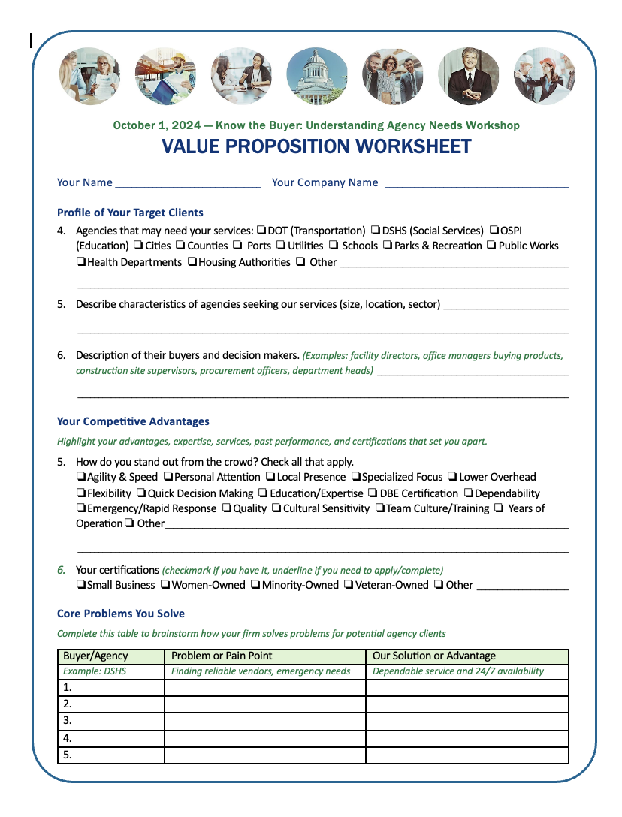
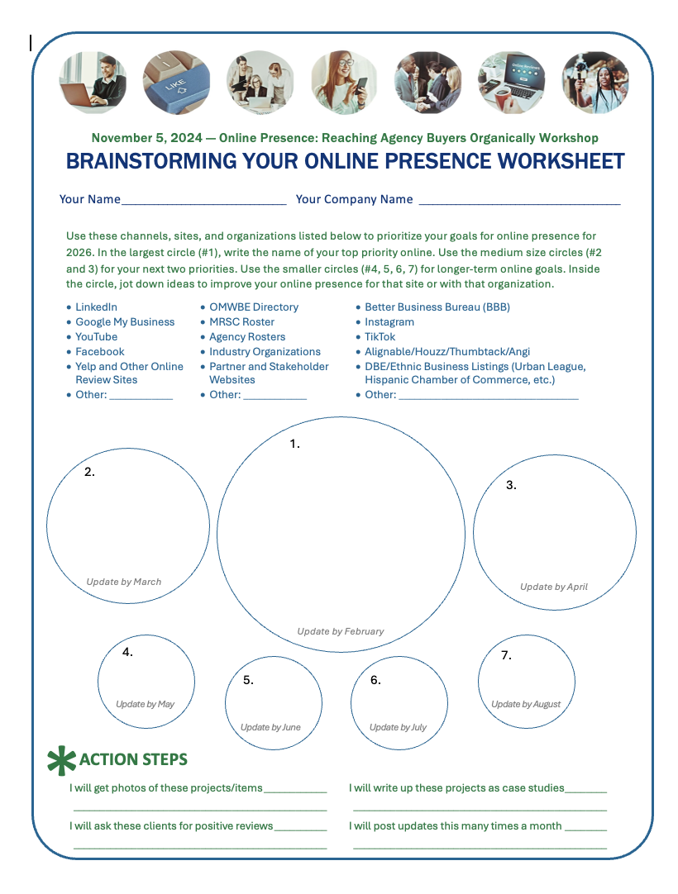
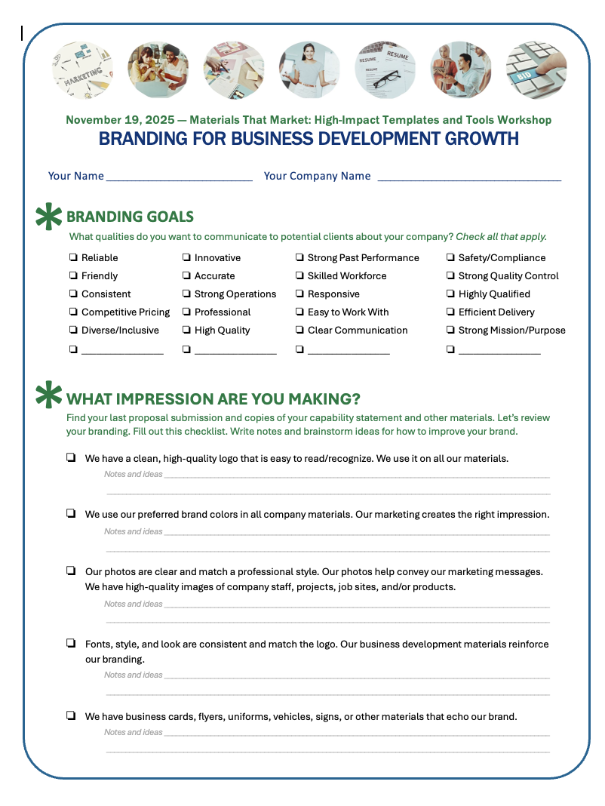
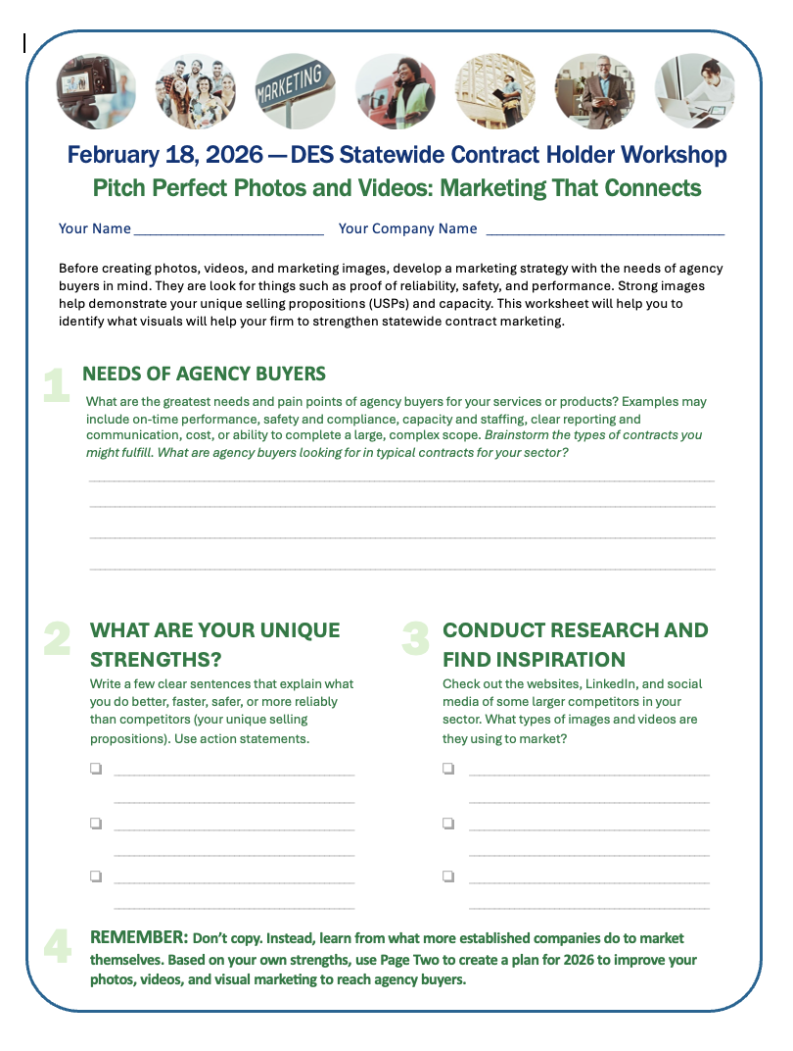
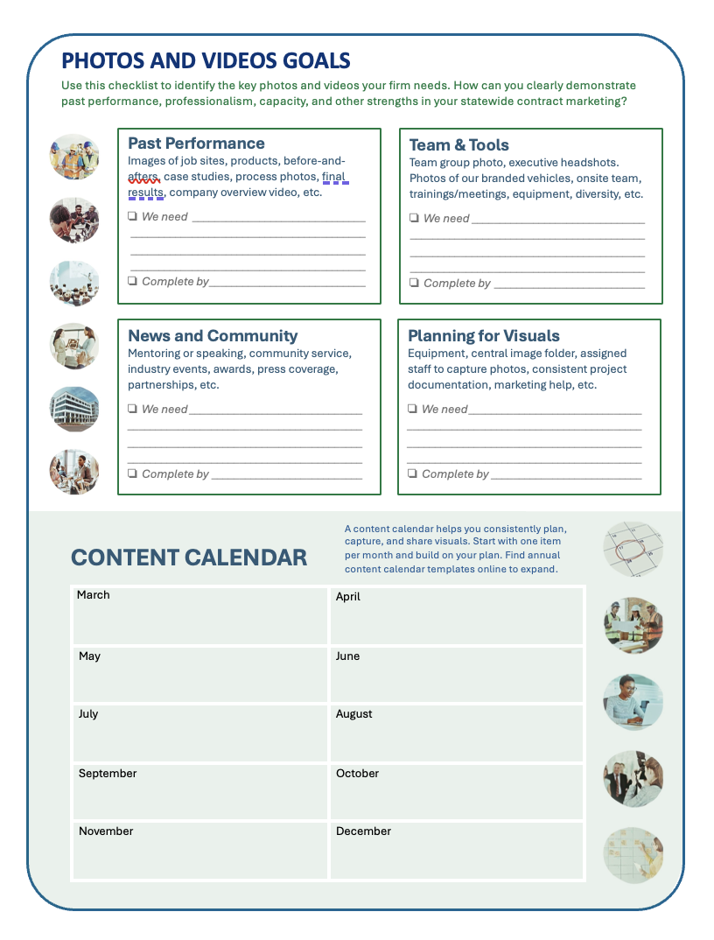
Worksheet
Want to dig deeper on the topic of emails and newsletters? Every session we provide tutorials, tips, and creative brainstorming ideas for you to plan your next steps. Let’s take a quick look at this week’s exercise.

Slide 28

Reminder Before Q&A: Next Session
Wednesday, March 18th - 6:00 – 7:30 pm
Networking for Contracts: Building Relationships with Agencies

Slide 29

Q & A: Emails & Newsletters
What questions do you have about sending out emails and newsletters to potential agency clients who are looking to work with statewide contract holders?

Slide 30

Q & A: Statewide Contracting
What questions do you have about managing or marketing your statewide contract, WEBS, reporting, or other topics?

Slide 31
Closing
Thank you to DES for sponsoring the Learn & Grow: Statewide Contract Holder Workshop Series!
If you need support, reach out for resources.
The workshop presentation and handouts will be emailed to you.
Next workshop is Networking for Contracts: Building Relationships with Agencies, Wednesday, March 18 at 6:00 pm.

Slide 32
Thank You! See you next time!
Ryan Taylor
206-397-7872
ryan@goldengiftconsulting.com
www.goldengiftconsulting.com

