Slide 1



Know the Buyer: Understanding Agency Needs
Learn & Grow Workshop Series
Presented by
Ryan Taylor, President Golden Gift Consulting
October 1, 2025

Slide 2

Agenda
Welcome and Introductions
Workshop—State Contracting Basics
OFM Vendor Payee Registration
Sales Reporting
Small Business Registration & Certifications
Scope & Quote Process
3. Workshop—Know the Buyer: Understanding Agency Needs
4. Q & A and Discussion (Workshop Topic)
Q & A about Statewide Contracts
Closing Remarks

Slide 3
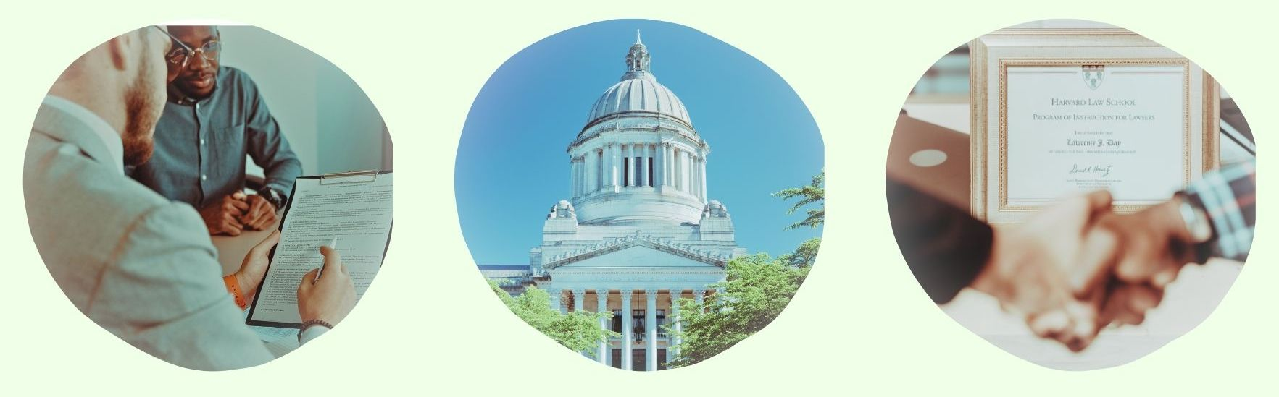
State Contracting Basics:
OFM Vendor Payee Registration
Sales Reporting
Small Business Registration & Certifications
Scope & Quote Process

Slide 4
OFM Vendor Payee Registration
Register for OFM at: Vendor payee registration | Office of Financial Management
Enter business information.
Enter bank account information.
Watch email for notification of acceptance, rejection or clarification.

Slide 5
Sales Reporting
Complete Sales Report at the following link: Login.
Pay management fee for all revenue generated through statewide contract during quarter. The Management fee amounts can vary. You can locate the exact details about your management in your official contract document.
Gross receipts = total revenue, not profit.
Invoice will be posted in account and emailed to you.
You must call the DES payment processing department at (360) 725-5700 to pay your invoice. You cannot pay through an online account.

Slide 6

Small Business Registrations & Certifications
Small business certifications (small business, veteran, MBE/WBE, etc.), if any, are listed next to firms on the DES contract portal page.
If you obtain OMWBE certification (or your certification status changes) after your contract award, notify the contracting officer so your file can be updated.

Slide 7

Scope & Quote Process
Agencies will research firms
They conduct preliminary research to narrow firms.
You should consider what the agency is looking for.
Outreach process
Agencies reach out to vendor(s) of interest and request quotes.
Agencies may request
Technical approach.
Firm/staff qualifications.
Price quote (cost for firm’s services, materials, and other direct costs related to the scope of work).

Slide 8

Understanding The Needs of Your Buyers:
Identifying and Defining Value Propositions
Research Buyers
Qualify Buyers

Slide 9

Step 1.1: Value Propositions – Identify Target Clients
Identify your target clients.
Determine agency type/sector. What type of agency would buy my firm’s goods or services?
Determine which programs and departments within the target agencies would be most likely to purchase my goods or services. Which departments and or programs within my target agencies have the strongest need for my goods or services?
Determine agency size. What size agency would my firm’s services be best suited for?
Determine agency location. My firm can best serve agencies in the following locations ______.
Describe other characteristics that would make an agency a good prospective client for your firm.
What types of representatives do I need to connect with to best market services to my firm’s target agencies?

Slide 10

Step 1.2: Competitive Advantages
What competitive advantages set my firm apart from the competition?
Examples could include:
Quality of work
Years of experience
Capacity
Flexibility (or many more, see worksheet)
What certifications, licenses, or other credentials would serve as a competitive advantage?

Slide 11

Step 1.3: What Problems Do You Solve?
Create a list of the top 3–5 problems your firm solves.
What makes your firm’s solutions effective? Is it a one-time implementation or does it require follow-up support? What is the scope and scale of the follow-up?
What makes your firm’s solutions unique? Are other firms doing this? Are other firms doing this as effectively as you are?
Can you customize your solutions to meet client needs? If so, how do you do so? What are the results?

Slide 12
Step 1.4: Develop Value Proposition Statements
Develop Value Proposition Statements:
Example 1: Kenneth Wise Janitorial specializes in effectively and efficiently applying the use of green environmentally friendly products. This allows Kenneth Wise to provide top notch janitorial services and maintain a chemically safe environment. The firm provides optimal janitorial support to public agencies, leveraging its team’s 30+ years of janitorial, medical grade sanitation and operations management experience, and its meticulous quality assurance program.
Example 2: Smith & Jones Business Consulting delivers high quality management consulting by using its proven proprietary systems and applying its two principal staff members’ 25+ years of experience.
For each Value Proposition, provide supporting evidence:
Example 1: Use of green projects on all projects, green products used and applied in a cost-efficient manner, documented 30+ years of experience, successful past performance, proven use of its quality assurance systems.
Example 2: Documented 25+ years of experience in areas stated, proven use of its proprietary systems, successful past performance, duration of results.

Slide 13
Step 2: Research Agency Past Buying Trends
Researching prospective client agencies’ past spending trends will help you gain insight into which buyers you should target based on their past purchasing of goods or services your firm provides.
Using the following methods, you will gain insight into which agencies purchased the goods or services your firm provides.
You will gain insight into how much each agency spends with your competitors on similar goods or services
Using the tools, you can identify the quantities of goods and services previously purchased by agencies, along with associated timeframes.

Slide 14
Step 2: Research Past Agency Spending Using fiscal.wa.gov
Select “Recipient” in drop down.
Select “Agency” in drop down.
Select “Category“ in drop down.
Select “Month and Year Range” in drop down.
Use agency past spending research database provided at www.fiscal.wa.gov.
Identify competitors on statewide contract.
Select “Biennium” at the top.
Note: Tool was recently created and does not include past bienniums.

Slide 15
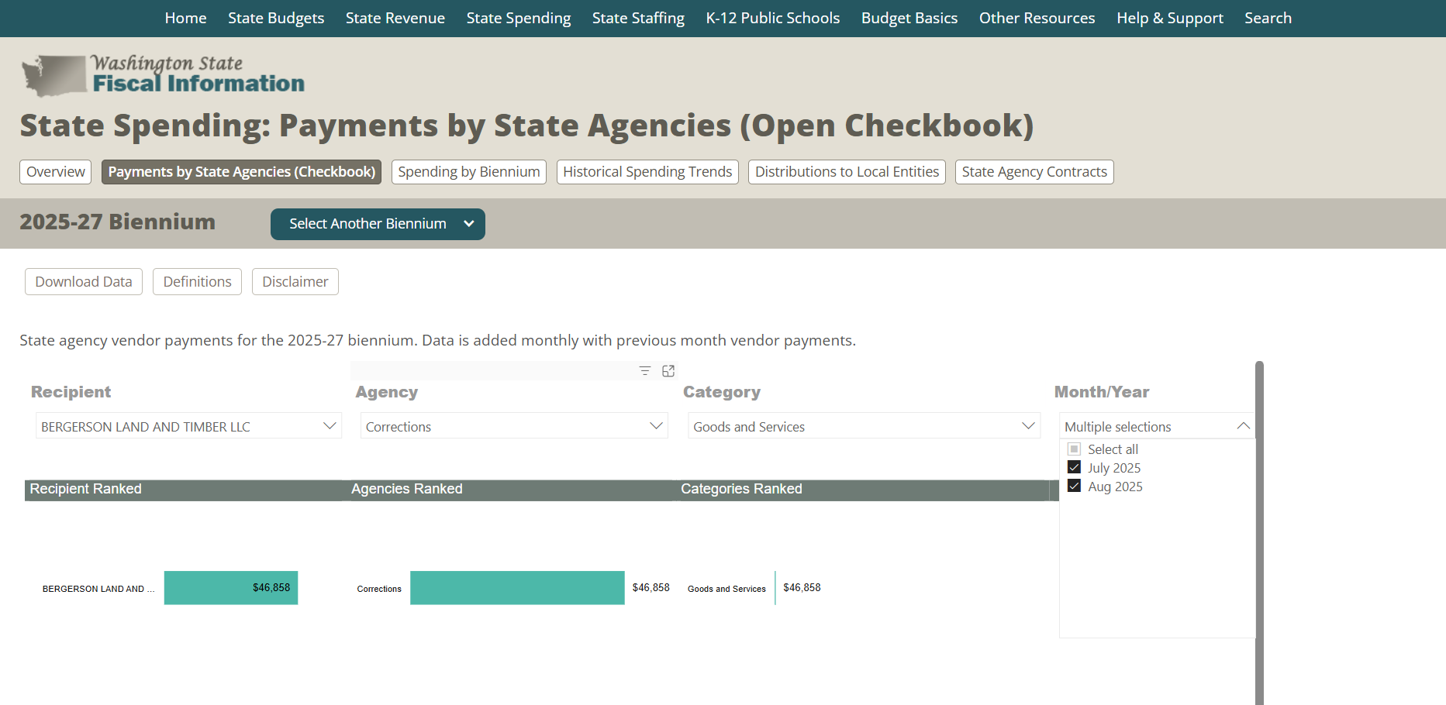

Slide 16
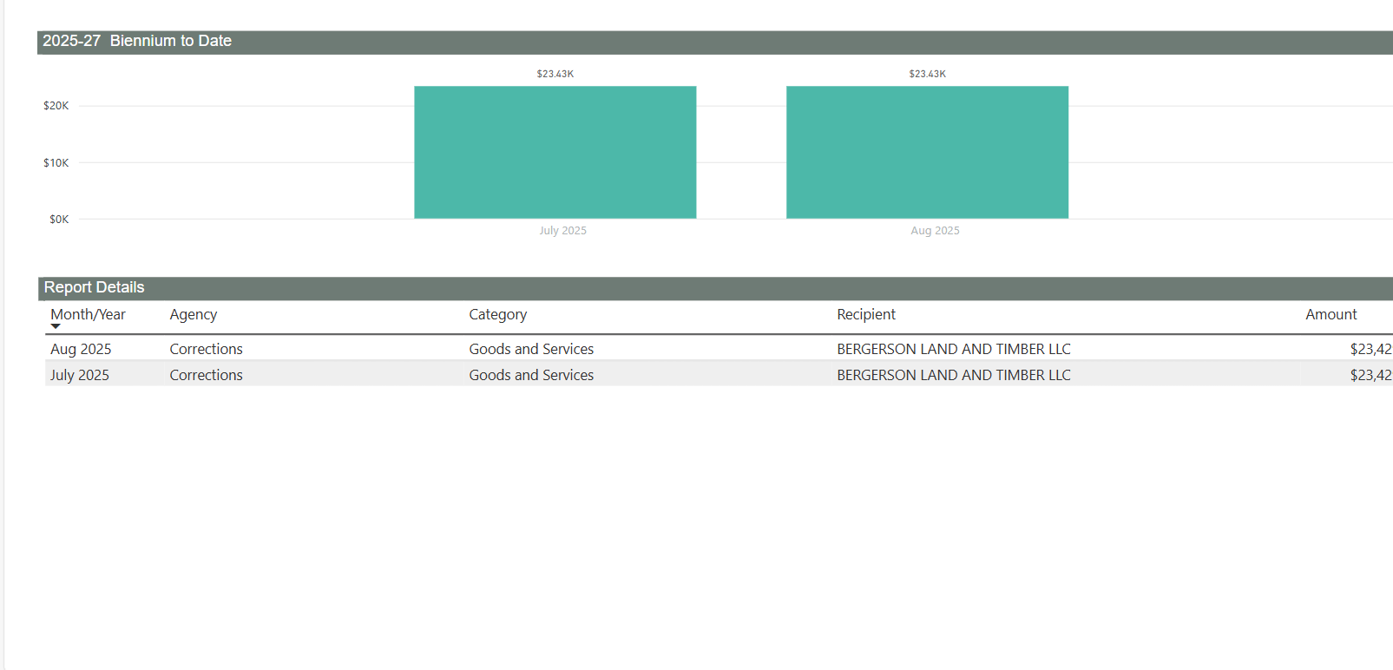

Slide 17
Step 2: Research Past Agency Spending Using WEBS Database
1. From left hand menu, Select “Search Opportunities.”
2. Select “Select Advance Search” in drop down.
3. Select agency in “Organizations” drop down.
4. Enter “Keywords” related to goods or services.
5. Select “County” in drop down (if desired).
6. Select Commodity Code filtering option (if desired).
7. Select “Date Range” (if desired).
8. Select “Solicitation Type” (if desired).
9. Select “Open or Selective” in drop down (if desired).
10. View results and open solicitation announcements.
11. Reference information in announcement listing and download solicitation document to review and reference.
Use WEBS to search for agencies that have issued solicitations for relevant services.
This can help firm’s find agencies that may have bought other goods or services they sell outside of the scope of their statewide contract. Firms can look at scopes and ask for past winning bids.
If there was a previous contract for your firm’s goods or services, the solicitation(s) may not be available in WEBS if the procurement was done outside of WEBS. If this is the case, reference fiscal.wa.gov or contact a DES representative to see if your contract is part of the target market outreach program.

Slide 18
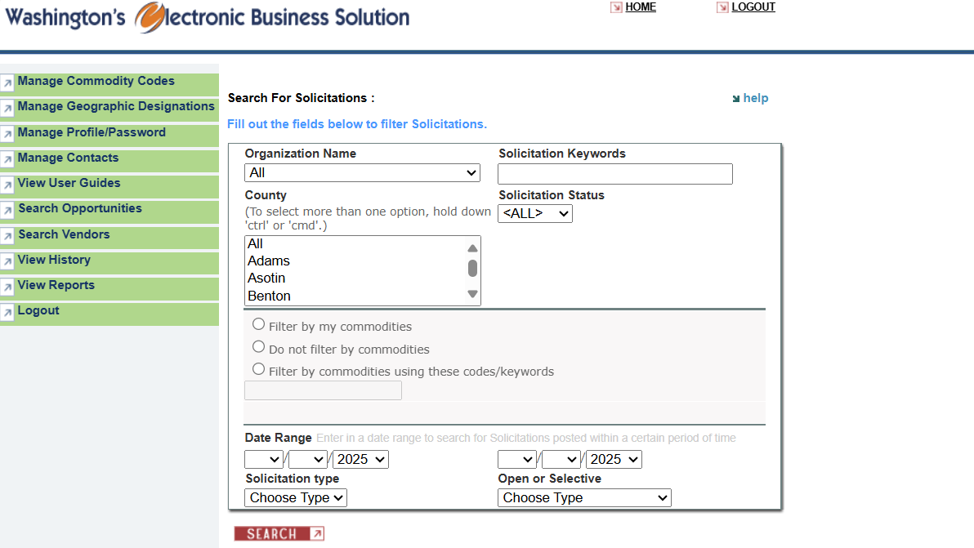

Slide 19
Reminder Before Q&A: Next Session
Intro to Prospecting: Researching Markets, Meeting Buyers, and Conducting Follow-Up
Learn how to identify target markets and then research past purchasing history for target agencies. Create impactful prospecting goals. Implement a prospecting plan to start conversations, follow up effectively, and establish relationships that lead to real contract opportunities.
Wednesday
October 15
6:00 – 7:30 pm

Slide 20

Q & A: Response to Inquiries
What are your questions about understanding agency needs?

Slide 21

Q & A: Statewide Contracting
What are your questions about managing or marketing your statewide contract, WEBS, reporting, or other topics?

Slide 22
Closing
Thank you to DES for sponsoring the Learn & Grow Statewide Contract Holder Workshop Series!
If you need support, reach out for resources.
The workshop presentation and handouts will be emailed to you.
Next workshop is Intro to Prospecting: Researching Markets, Meeting Buyers, and Conducting Follow-Up Wednesday, October 15, at 6:00 pm.

Slide 23
Thank you! See you in two weeks.
Ryan Taylor
206-397-7872
ryan@goldengiftconsulting.com
www.goldengiftconsulting.com

