Slide 1



Websites That Work: What Buyers Want from Your Site
Learn & Grow Workshop Series
Presented by
Ryan Taylor, President Golden Gift Consulting
September 3, 2025

Slide 2
Agenda
Welcome and Introductions
Workshop—State Contracting Basics
OFM Vendor Payee Registration
Sales Reporting
Small Business Registration & Certifications
Scope & Quote Process
Workshop—Websites That Work: What Buyers Want from Your Site
Website Layout
Website Presence
Contact Page and Information
Q & A and Discussion (Workshop Topic)
Q & A about Statewide Contracts
Closing Remarks

Slide 3

State Contracting Basics:
OFM Vendor Payee Registration, Sales Reporting, Small Business Registration & Certifications, Scope & Quote Process

Slide 4
OFM Vendor Payee Registration
Register for OFM at: Vendor payee registration | Office of Financial Management
Enter business information.
Enter bank account information.
Watch email for notification of acceptance, rejection or clarification.

Slide 5
Small Business Registrations & Certifications
Some small business registrations (small business, veteran, MBE/WBE, etc.) are listed next to firms on the DES contract vendor list.
If you obtain OMWBE certification after your contract award, notify the contracting officer so your file can be updated.

Slide 6
Scope & Quote Process
Agencies will research firms
They conduct preliminary research to narrow firms.
You should consider what the agency is looking for.
Outreach process
Agencies reach out to vendor(s) of interest from which to request quotes.
Agencies may request
Technical approach
Firm/staff qualifications
Price quote (cost for firm’s services, materials, and other direct costs related to the scope of work)

Slide 7

Websites That Work: What Buyers Want from Your Site

Slide 8
Website Layout: Homepage
Make sure home page has clear and concise text.
Give brief descriptions of important elements of your business.
Make website easy to navigate and find things.
Contact info should be on the first page and on a Contact page.
Use professional photos and graphics if possible.
Use your branding (logo, company colors, style/feel) to convey your company’s qualities including professionalism, consistency, attention-to-detail, strong team culture, etc.

Slide 9


Slide 10
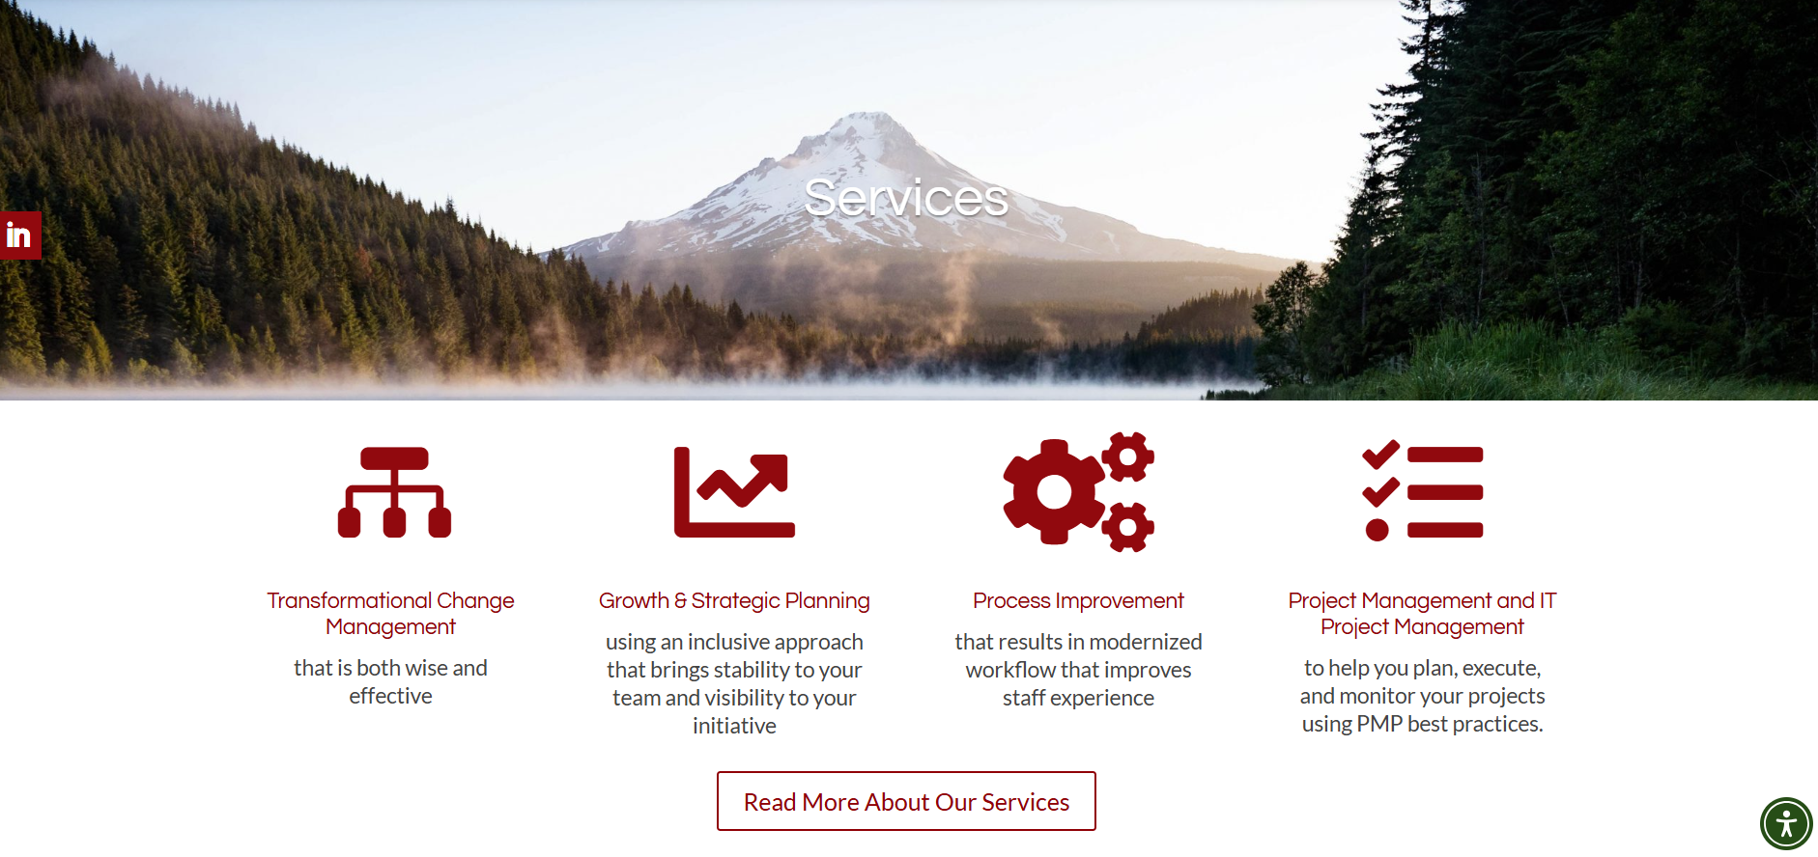

Slide 11
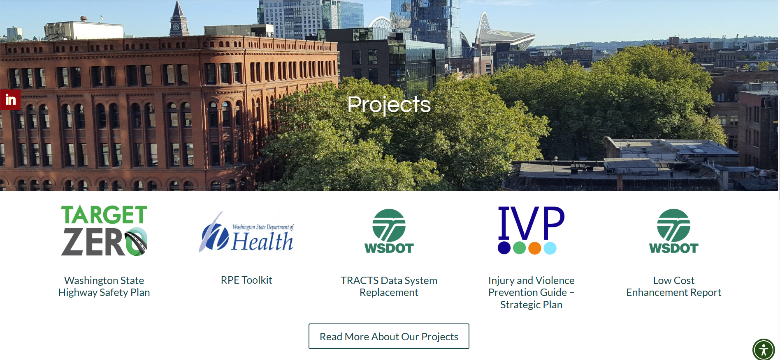

Slide 12
Website Layout: Services or Goods/Products Page
Clearly describe service offerings or goods/products including those related to the contract.
Be specific, as if you’re talking to a person outside of your field. Don’t be general, expecting potential buyers to put things together or fill in the gaps.
Highlight any niche, unique offerings, differentiators, or industry credentials that will make you stand out from the crowd.
Some businesses on the vendors list may be large corporations. Clearly state your small-firm advantages (responsiveness, faster turnaround time, niche expertise, owner-led oversight, etc.).

Slide 13
Website Presence: Past Projects or Experience Page
Your past performance is proof that you can deliver required services or goods/products.
List past projects related to the contract’s scope of work.
Include name of project, location, type of work, industry-recognized tools or systems utilized, and outcomes.
Include details such as project duration, size and location, challenges overcome, and other measurable results.
Provide testimonials, if possible.
Link to case studies for more in-depth proof of past performance.

Slide 14
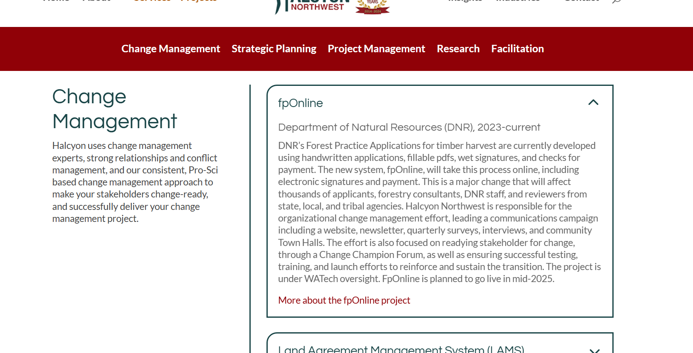

Slide 15
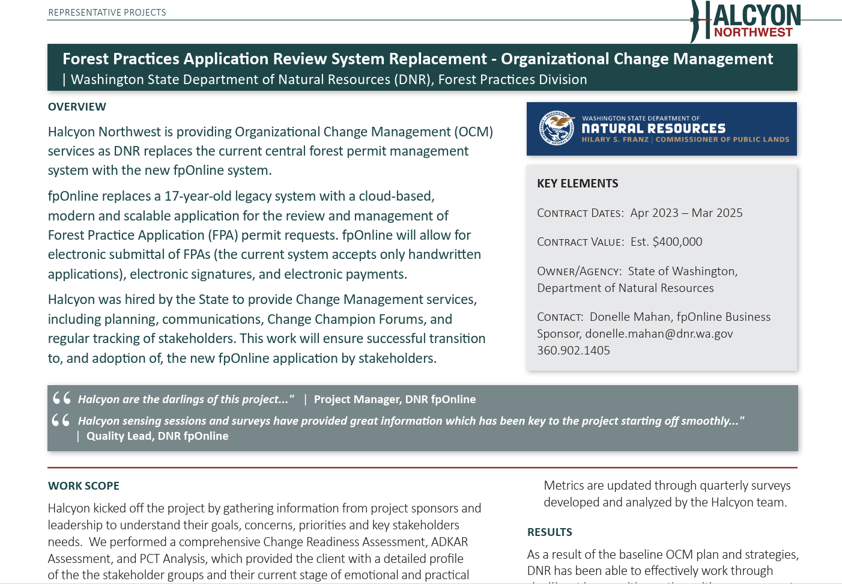

Slide 16
Website Presence: List Key Staff and Relevant Qualifications
Include key staff bios and, if possible, professional photos.
Highlight relevant skills, credentials, experience, and education.
Ensure bios are clear, concise, and compelling.
Consider including links to LinkedIn and/or relevant staff publications.

Slide 17
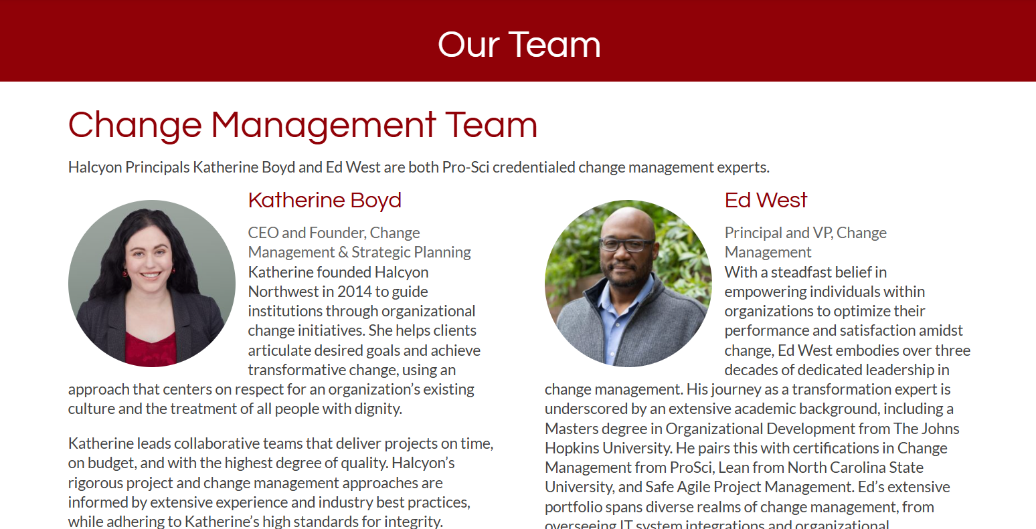

Slide 18
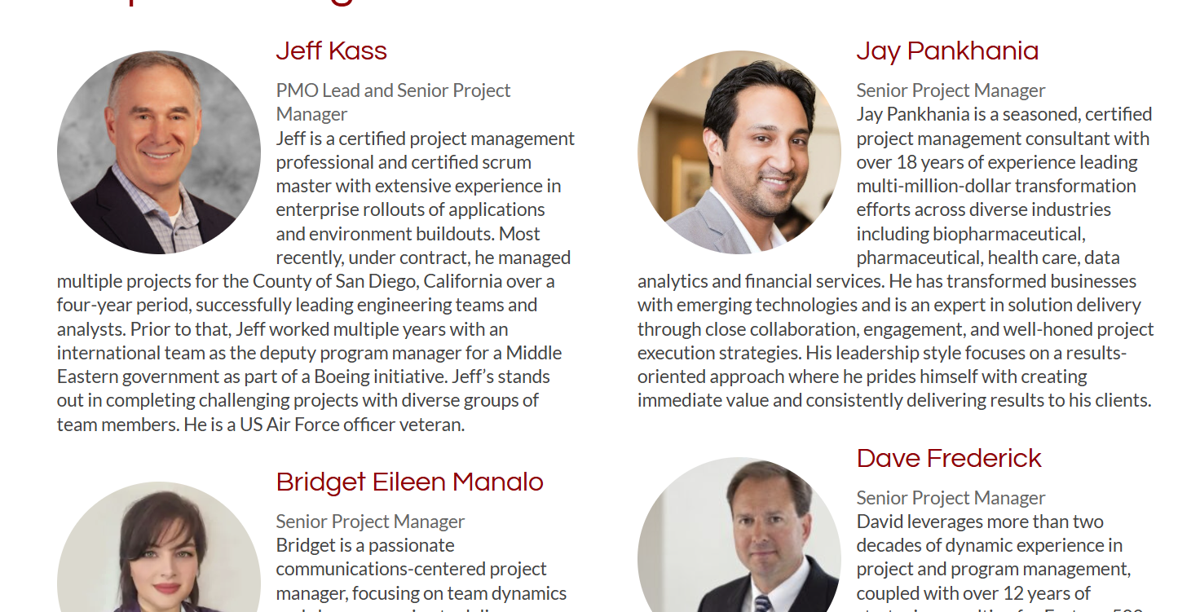

Slide 19
Website Presence: About Us
An About Us page with your company overview and story can help personalize your site and show agencies the story of your growth.
The About Us page can also mention your mission and values.
A professional photo of your team or firm owners can help agency buyers connect with your company.
You can list NAICS codes, certifications, differentiators, and core capabilities here.

Slide 20
Contact Page and Information
Make sure your contact page is easy to find in the menu and that your contact info is also located on your home page.
Provide a contact form or email address.
Including a phone number helps interested agencies contact you quickly.
Add a clear but discreet “Contact” link on every buyer-facing page. Provide contact info without feeling salesy. Make your value the focus.

Slide 21
Reminder Before Q&A: Next Session
Stronger Bids: Agency Inquiries, Requests for Scope and Quote,
Learn how to prepare strong responses to inquiries and requests for quotes, including pricing, past performance, team qualifications, and technical approach.
Wednesday
September 17
6:00 – 7:30 pm

Slide 22
Q & A: Websites
What are your questions about how we can reach agency buyers through company websites?

Slide 23
Q & A: Statewide Contracting
What are your questions about managing or marketing your statewide contract in general, WEBS, reporting, or other topics?

Slide 24
Closing
Thank you to DES for sponsoring the Learn & Grow: Statewide Contract Holder Workshop Series!
If you need support, reach out for resources.
The workshop presentation and handouts will be emailed to you.
Next workshop is Stronger Bids: Agency Inquiries, Requests for Scope and Quote on Wednesday, September 17, at 6:00 pm.

Slide 25
THANK YOU! See you in two weeks.
Ryan Taylor
206-397-7872
ryan@goldengiftconsulting.com
www.goldengiftconsulting.com

